Slide 1
Programming in C a C++
Ing. Radek Zahradník, Ph.D.

Slide 2
Outline
Basic concept of software developing
History C & C++
Basic concepts of C & C++
Data types
Operators
Terminal input/output
Flow control
Pointers, arrays & strings
Functions
File input/output
Preprocessor
And many more…

Slide 3
Before we continue…
Where to get the codes? Google -> Radek Zahradník GitHub -> Repositories > C-CppCourse https://github.com/KUTlime/C-CppCourse
What IDE do you use? Say hello to CLion On Windows 11 -> Terminal as Admin -> winget install clion -h

Slide 4
Introducing to software development (on Windows)

Slide 5
What MS Windows offer
MS Windows => a wide range of app development possibilities.
We could develop: - Console applications - GUI applications - Service applications
Microsoft supports a development with C++ via its proprietary tools like Visual Studio (with C++ compiler), a target machine support packages etc.
C/C++ is not limited only for Windows or only by use Visual Studio.

Slide 6
Disclaimer
We will be using Console application only because: - This is a language-oriented course. - GUI application are non-standard, platform and version dependend. - GUI applications are quite complicated for beginners (sometime even messy).

Slide 7
Start with some story…
…Barclays in Praha 03/25.
Uncle Ben

Slide 8
Basic concepts of building C & C++ application

Slide 9
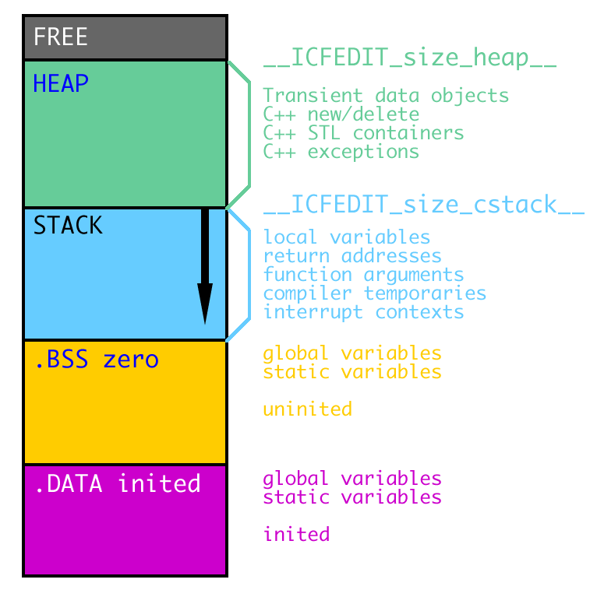
Program memory types
From application (or developer) point of the view, there are three different types of memory storage: - static memory - stack - heap
All serves different purpose.
Developer: - doesn’t have a direct access to static memory, - should take special care about stack, - always worry about a heap memory leak.

Slide 10
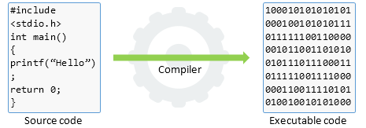
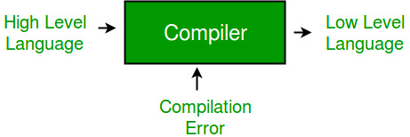
Compiler
Responsibility for transformation of the high-level source code into a low-level machine code.
Various implementation according different standardizations (ANSI, ISO) or language revisions (C++11, C++14, C++17 …)
Particular implementation has an effect on performance.
Platform-specific
Extensive setting for optimization: - build speed - size of binary files - performance of the binary files
Pain on implementation & versions list of support in compilers

Slide 11
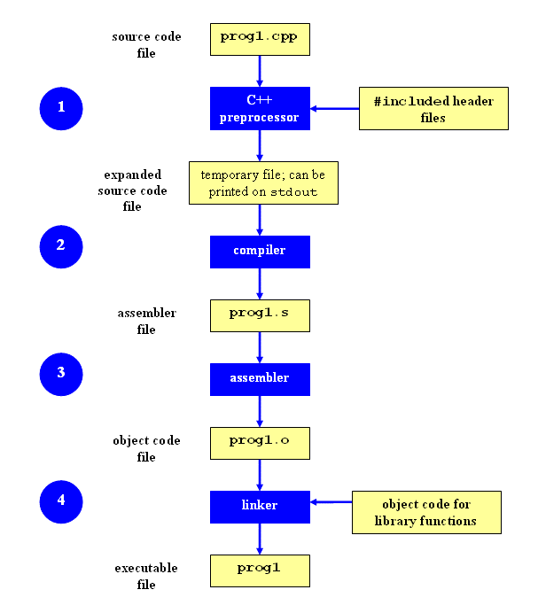
Build process of C/C++ application
Binaries (exe or dll files) are product of the build process.
A preprocessor, a compiler, an assembler and a linker is called respectively to produce final binary code.
The build process is highly sophisticated, a platform specific, on-developer demanding task.

Slide 12
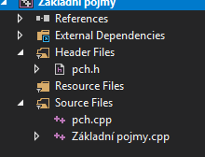
*.cpp vs. *.h
*.h – header files (headers)
*.c – source codes (C language)
*.cpp – source codes (C++ language)
*.ixx – modules (C++20 in Visual Studio)
Separation of definition and declaration.
Header files – definitions for a compiler
Source codes – execution code for a compiler
Headers describes the execution code for a compilator and enables the build process.
The source code can be merged to header files.
The header includes with *.h, without *.h referrers to C library, C++ library, respectively.

Slide 13
Application changes
Application change – the need to change the source code
Every change requires recompilation of the binary code.
x86 <-> x64 – recompilation

Slide 14
History and basic knowledge of C & C++

Slide 15
What is C?
No.2 in popularity – TIOBE Index.
The language most syntactically influenced the world.
Created by Dennis Ritchie between 1969 and 1972 in Bell labs for UNIX.
Low-level, compiled, minimalistic imperative language.
Today use mostly for a system software (almost every HW except high-level PC apps, OS core, drivers etc.)
A simple compiler (easy to implement to various platforms) => a high portability.
Almost all C programs are valid C++ programs.
Why C? There was the B language already.

Slide 16
What is C++?
C++ is almost a superset of C and shares its basic syntax for variable declarations, primitive types, and functions.
A general purpose, multi-paradigmatic, strongly typed language with support for OOP, imperative and generic (a data abstraction) programming.
Created by Bjarne Stroustrup between 1979 and 1985.
Used for a high-level portable programming.
A slow development, a complicated syntax (for both humans and compiler), hard to learn the latest versions of C++ revisions.
Firefox, Chrome, parts of Linux & MS Windows, MS Office, Adobe software or many programming language itself are written C++.
Why C++? You will soon find out. ☺

Slide 17
History notes about C
C has standardized revisions by ISO committee and ANSI (used in USA).
C standards are: - ANSI C (two revisions C89 and C90) - ISO C99 - ISO C11 - ISO C18

Slide 18
History notes about C++
C++ has standardized revisions by ISO committee.
C++ standards are: - C++98 - C++03 (mostly a bug fix release) - C++11 (standardized TR1 release, a real extension) - C++14 (a small maintenance release) - C++17 (a real extension) - C++20 (a real extension) - C++23 (the latest extension)
Feature/bugs are often backported to previous standards.
C++ suffers from a slow, buggy, sometimes even chaotic development.

Slide 19
Data types (start-up overview)
int = integer (0, 1, 2, .. or -1, -2, …).
double = double precision flouting point value (0.0, 1.0, 1.1, 1.00001 etc.)
char = character (‘a’, ‘b’, …)
string = array of chars

Slide 20
Operators (start-up overview)
+, -, *, / => adding, substracting, multiplaying, division
++, -- => incrementing/decrementing by one
<, >, <=, >= => less/greater than, less/greater or equal than
% => modulo, reminder after integer division a, b operands + operator
x = a + b;

Slide 21
Basic syntax

Slide 22
Introduction to basic syntax (C++)
Syntax (and a program) consists: - statements - comments - function call - variable declaration - preprocessor directives - control flow etc.
// Comment - a line type
/*
Multi line comment
Multi line comment
*/
#include <cstdio> // preprocessor directive
int main(int argc, char argv)
{
puts("Hello, World!");
return 0;
}

Slide 23
Anatomy of a C++ program
Tokens – items separated by white space (a space, new line) except #include.
2 types of comments
One and only one Main function.
Shortening a long identifier by using.
Standard return value – 0.
// Comment - a line type
/*
Multi line comment
Multi line comment
*/
#include <cstdio> // preprocessor directive
using namespace std;
int main(int argc, char argv)
{
puts("Hello, World!");
return 0;
}

Slide 24
Anatomy C++ function main
Only one per application.
Entry point to our application – the main function is called by OS.
Standard return value – 0, can be omitted.
Two input arguments: - A number of input arguments - A pointer to pointer to the argument list
int main(){} // A minimal variant
#include <iostream>
int main(int argc, char argv)
{
std::cout << "Hello, World!";
}

Slide 25
Statements and expressions
Statement is always terminated by semicolon ;
Expression is anything which returns a value.
Expression could be a part or even entire statement.
int main()
{
int x; // statement
x = 42; // assignment expression
printf("x is %d\n", x); // x is expression, whole line is an expression
return 0;
}

Slide 26
Identifiers
Readable names for variables, functions and user types.
Case sensitive.
Use of: (ASCII) a-z, A-Z, 0-9 and _ (underscore).
0-9 can’t be the first char of identifier.
Identifier can’t be a reserved word, e.g. return. Full list here and here.
_A-Z or __ reserved for pre-processor and system use.
_a-z used for private members (#BestPractise)
Camel vs Snake wars
int main()
{
int x; // statement which creates an identifier x
x = 42; // assignment expression with identifier x
printf("x is %d\n", x); // x is expression because it is a use of an identifier
return 0;
}

Slide 27
Defining variables
C++ is strongly typed language => variable token represents both value & type.
Variable is a typed and a named of location in memory => variable name is an index of a memory address.
Definition of variable: int x; => naming and allocation of required type.
Assignment of variable: x = 7; => coping a value 7 into memory associated with variable name x.
Assign a variable before use!!! Join definition and initialization. (#BestPractise)
Variable can be marked like constant by const keyword. Use it everywhere you can. (#BestPractise)
You can define two variables at once. (#NotAGoodPractise)

Slide 28
Chapter quiz
What is the coding paradigm supported in C++? (generic, Object-Oriented, Imperative)
Which function is the entry point to a C++ program? (main)
How do you bring a namespace into your code so you do not have to prefix the function name with that namespace? (using namespace)
How do we terminate a statement in C++? (semilon ;)
Why is the variable with name “return” invalid? (return is C++ keyword)

Slide 29
Procvičování základní syntaxe
Nadefinujte jednoduchý C++, ve kterém nadefinujete tři proměnné typu int, tři proměnné typu double a tři typu char. Nastavte pevné hodnoty všem proměnným. (char znakA = 'a')
Vytiskněte je na obrazovku. Pro tisk použijte tento řádek: std::cout << název.
Uložte do třetích proměnných součet dvou předchozích.
Vyzkoušejte si dělení čísla double hodnotou int a sledujte, co se stane.
Nadefinujte proměnnou typu int, nastavte ji na hodnotu 0, použijte na ji operátor ++ (stačí takto: proměnná++;). Vytiskněte její hodnotu. Zkuste postup opakovat pro operátor --. Pokud vám není jasné, co se odehrává na pozadí, zeptejte se.
Změňte váš program, aby nevracel 0. Pozorujte, co se stane.

Slide 30
Data types & type system

Slide 31
Overview of data types
C++ => a strongly typed language
Strongly typed language => every variable has specific type which has a specific size.
C++ consists: - Integer values - Floating-point numbers - Booleans (bool, can be true/false) - User types (structures, classes and unions) - Enumeration - Array (of same type) - Pointer - Reference

Slide 32
Integral types
Representing integer numerical value.
Two different major types – signed and unsigned.
Defined as minimal value for …
Actual size depends on platform and compiler!!!
Standardized versions of integers should be used in portable code. int vs int32_t (Fixed size list)
int can be omitted but isn’t a good practise
Full reference
int = fits to a natural target processor size.
Integer literals => 42L, 42LL, 42U or 0YYY for octo, 0xYYYY for hex, 0bYYYYY for binary (C++14).

Slide 33
Floating-point types
Representing real numerical values.
Three main types: - float (4 bytes) - double (8 bytes) - long double (16 bytes)
Number literals (1e2, 1.0F, 1.0L)
What should every computer scientist know about floating point (original article & modern version)

Slide 34
Characters and strings
Fundamental string => c-type string => null-terminated string => an array of characters with 0 at the end.
Technically, char is an integer. A conversion table is used to transfer between integer value and character value (e.g. ASCII).
Small, simple, fast, mutable.
Syntax:
Literal: “Some string”
char myword[] = { 'H', 'e', 'l', 'l', 'o', '\0' };
char myword[] = "Hello";
std::cout("Hello, World!");
myword[0] = 'B';
myword[1] = 'y';
myword[2] = 'e';
myword[3] = '\0';
char ch = ')'; // Literál znaku - zápis mezi jednoduché uvozovky

Slide 35
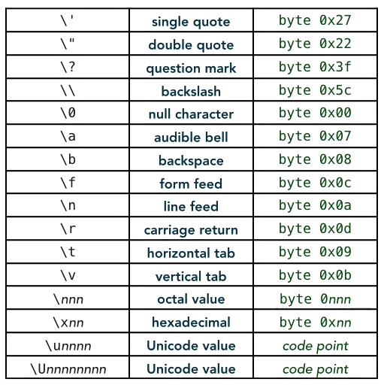
Character-escape sequences
A special syntax in string for special characters.
They brings a character which are not available otherwise.
Compatible with std::cout, puts, printf.
std::cout("Hello, World!\n");

Slide 36
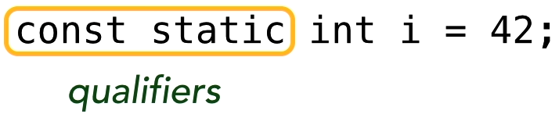
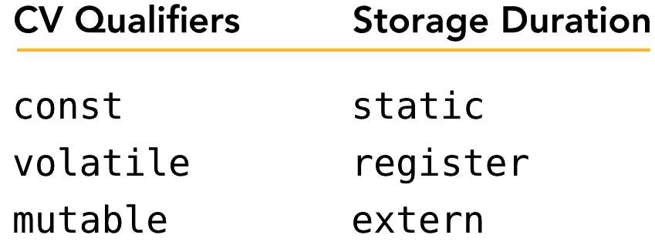
Qualifiers
Instruction for compiler about variable mutability or storage duration.
CV – constant/volatile
Const => immutable variable
Volatile => possible mutation from another thread
Mutable => override for constant member functions write access.
Static => application-long lifetime of the variable, stored globally.
Register => suggestion for compiler to store variable in register
Extern => external, linked variable
Default lifetime => within the block {}

Slide 37
Structured data
No much use in C++ because of classes.
Only difference is a default visibility => struct members are public by default.
A legacy of C.
Syntax definition: struct Name_of_struct {// data} optional_object_names;
At the end, before semicolon, there could an optional instance names.
struct Complex
{
private:
float real;
float imaginary;
}
class Complex
{
float real;
float imaginary;
}
==
class Complex
{
public:
float real;
float imaginary;
}
struct Complex
{
float real;
float imaginary;
}
==

Slide 38
Bit fields
#include <iostream>
struct S
{
// will usually occupy 2 bytes:
// 3 bits: value of b1
// 2 bits: unused
// 6 bits: value of b2
// 2 bits: value of b3
// 3 bits: unused
unsigned char b1 : 3, : 2, b2 : 6, b3 : 2;
};
int main()
{
std::cout << sizeof(S) << '\n'; // usually prints 2
}
Provides an ability of pack multiple values in less space than would normally take.
Definition syntax: Type_of_variable name_of_variable : number_of_bits;
Bit order or byte size is not guaranteed. A target compile architecture will decide.

Slide 39
Enumerations
A distinct type whose value is restricted to a range of values.
May include several explicitly named constants ("enumerators").
The values of the constants are values of an integral type known as the underlying type of the enumeration (int by default).
Many uses, e.g., grouping range of values which are related (e.g. GUI possibilities).
Definition syntax: enum Variable_name {value1, value2 …}

Slide 40
Unions
A special type that can hold only one of its non-static data members at a time.
Allows use of same memory space for a different memory types.
#include <iostream>
union test
{
uint8_t number;
char ch;
};
int main()
{
union test demo;
demo.number = 65;
std::cout << "Union value: " << demo.ch << "\n";
}

Slide 41
Defining types with typedef
typedef unsigned char rank_t;
Providing alias for type name.
Useful with long definitions.
#include <iostream>
typedef long long int lli;
int main()
{
lli x = 42;
std::cout << "Size of lli: " << sizeof(lli) << "\n";
}

Slide 42
The void type
Indication of lack of value for function parameters and inputs.
With void, no return value is required.
C: func(void) => No input arguments.
C++: func() => No input arguments.
Void used as input parameter of function in C++ is just compatibility with C.

Slide 43
The auto type
A new meaning to auto keyword => auto deduced type based on the context.
Extremely handy feature.
Reduces errors related to iteration through containers from the STD library.
The compiler will deduce the type during compilation.
#include <iostream>
using namespace std;
auto Add(int i, int j) {return i+j;}
int main()
{
map<int,list<string>> m; // Definiton of map container.
map<int,list<string>>::iterator i = m.begin(); // Definition of iterator for the map
auto j = m.begin(); // Removing the definition redundnes from the iterator.
auto k = Add(1, 2);
vector<int> dqDoubleData = {1, 2, 3, 4, 5};
for (const auto& elem : dqDoubleData) // observes elements IN-PLACE
{ /* ... */ }
}

Slide 44
Chapter quiz
The type that is a set of overlapping object types is? (union)
Which one of the types is available in both signed and unsigned version? (integers)
What is the size of the floating-point double? (8 bytes)
Can you escape special characters in a string such as a double quote using a forward slash? (No)
What is defined in a separate translation unit and is linked with the code by the linker step of the compiler? (extern)

Slide 45
Tasks for practise
Design a union for easy-to-use for setting a file permission. The permission should be: - read access - write access - full controll - hidden index - shared over network (hint: a right structure could help you inside the union)
Notes:
#include <iostream>
struct FilePermissions
{
bool read : 1;
bool write : 1;
bool full : 1;
bool hidden : 1;
bool shared : 1;
};
union FilePermission
{
uint8_t Rights;
FilePermissions filePermission;
};
int main()
{
FilePermissions accessRights;
accessRights.read = false; // Rights for reding of the file.
accessRights.write = false; // Rights for writing to the file.
accessRights.full = true; // Rights for full contgrol of the file.
accessRights.hidden = true; // If the file should be hidden.
accessRights.shared = true; // If the file should be shared.
FilePermission myFilePermission;
myFilePermission.filePermission = accessRights;
printf("File permission is: %d\n", myFilePermission.Rights);
myFilePermission.filePermission.hidden = false;
printf("File permission is: %d\n", myFilePermission.Rights);
}

Slide 46
Operators

Slide 47
Common operators
= (assignment operator) => copy a value from one object to another.
+, -, *, / (adding, subtracting) => creating a temporary object and assign it to lhs.
Remember: Integer division returns a mantissa of the result expression. Use modulo (%) for reminder.

Slide 48
Compound assignment operators
+= (compound addition assignment) c += a; // c = c + a;
Speed optimization => Call + (-, *, /) will produce two copy operations, creating/destructing of temporary objects. A compound operator will result in less overhead.
Available for overload.
Full list here.

Slide 49
Increment and decrement operators
++ (increment) => incrementation by one. a++;
-- (decrement) => decrementation by one. b--;
Unary operators => only one operand is necessary.
Prefix use => Value is incremented and returned. ++a;
Postfix use => Value is returned and then incremented. a++;
Can be overload.
Definition syntax for overload: Type Type::operator ++ () {} //prefix version Type Type::operator ++ (Type) {} //postfix version
Postfix version is slower => produces two copy & constructor & destructor call.
Prefix just call +=1.

Slide 50
Comparison (relational) operators
== (equal) => compares two objects, return true if equal.
!= (not equal) => compares two objects, return false if equal.
< (less than) => compares two objects, return true if left operand is less than right operand.
<= (less than or equal) => compares two objects, return true if left operand is less or equal to right operand.
Can be overloaded.
Full list here.
Spaceship operator <=> (three-way comparison)

Slide 51
Spaceship (three-way comparison) operators
Auto generated comparison operators ==, !=, <, >, <=, >=
You can still override auto generated operators.
Generated code is constexpr & noexcept.

Slide 52
#include <compare>
#include <string>
using std::string; #include <vector>
using std::vector;
#include <algorithm>
using std::sort;
class Employee
{
private:
int number; // Sorts by a value of this int
string name; // or by this string if we move it up
public:
auto operator <=> (const Employee& other) const = default;
Employee(string fullname, int arbitrarynumber) : name(fullname), number(arbitrarynumber) {}
};
int main()
{
Employee e1("Kate", 100), e2("Kate", 200), e3("Someone", 100); vector people{ e1,e2,e3 };
sort(begin(people), end(people));
}

Slide 53
Logical operators
Used for combining logical conditions.
&& (AND) => true if both operands are true.
|| (OR) => true if any operand is true.
! (NOT) => flips the true/false to false/true.
A number ≠ 0 is evaluated as true, including floating point numbers.

Slide 54
Bitwise operators
Enables to manipulate with bits in bytes.
No single bit operation => 1 byte is a minimal chunk of work.
Unsigned numbers => independent on implementation.
Signed numbers => dependent on implementation.
Available operations are logical operations and shifting operations.
They also creates compound operators.
Very effective => they use a native CPU instructions.
Extremely fast even for large objects.
Overload possible.

Slide 55
Bitwise operators II.
Bitwise AND, OR, XOR => &, |, ^, respectively.
Left, right shift => <<, >>, respectively.
/* C Program to demonstrate use of bitwise operators */
#include<stdio.h>
int main()
{
unsigned char a = 5, b = 9; // a = 5(00000101), b = 9(00001001)
printf("a = %d, b = %d\n", a, b);
printf("a&b = %d\n", a&b); // The result is 00000001
printf("a|b = %d\n", a|b); // The result is 00001101
printf("a^b = %d\n", a^b); // The result is 00001100
printf("~a = %d\n", a = ~a); // The result is 11111010
printf("b<<1 = %d\n", b<<1); // The result is 00010010
printf("b>>1 = %d\n", b>>1); // The result is 00000100
return 0;
}

Slide 56
Casting in C-style
Casting => a change of type in runtime.
Casting uses () like an operator syntax.
Syntax: TypeT Name = (TypeT)variable_to_cast;
A casting process from type A to type B must defined for operation B = (B)A.
C++ has more advanced logic related to casing (dynamic, static, const …).
/* C Program to demonstrate use of bitwise operators */
#include<stdio.h>
int main()
{
unsigned char a = 5;
uint8_t b = (uint8_t)a;
return 0;
}

Slide 57
The ternary conditional operator
Allows execution of a different code depending on the value of a condition.
Ternary => three operators.
Definition syntax: Condition ? Statement_if_true : Statement_if_false;
Often use as replacement for if.
Can be chained => Condition ? Statement_if_true : Condition ? Statement_if_true : Statement_if_false;

Slide 58
Determining the size of a type with sizeof
Determines the size of the object => sizeof(int32_t) is 4.
Returns constant std::sizeof_t value.
Can be used on any object.
Useful for checking or allocating a chunk of the memory.

Slide 59
Determining the type of an object with typeid
Uniquely identify a type of the object.
Returns string.
String itself is not very useful (platform depended).
Often used together with == operator.

Slide 60
Operator precedence
Order of operator evaluation in an expression.
1 * 2 + 6 / 3 = ?
Operators with same order => a predetermined associativity of the operators (left-to-right or right-to-left).
Always consider the order and the evaluation associativity.
Not sure? => Use parenthesis ().

Slide 61
Chapter quiz
What is the result of following expression? 14%3 = ? (2)
What is the result of the following? ! (true || true) (false)
The operator that has the highest precedence (from ++, +, %, &) is? (++)
What is the result of the following expression? !(!true) && !false (true)
What operator takes three operands? (ternary)

Slide 62
Practise
Try to determine the operator order execution for this expression: auto x = (a++ * (--b & ~0)) / a^b*sizeof(b&a) for a = 1, b = 2, x = ? (x = 4)
Write a program for determination of the size of the fundamental types. See possible output below.
Write a struct for describing a person. Choose your own attribute. Use it. Copy one person to another person.
Write a program with the following output:
The sizeof(char) is : 1 bytes The sizeof(short) is : 2 bytes The sizeof(int) is : 4 bytes The sizeof(long) is : 8 bytes The sizeof(long long) is : 8 bytes The sizeof(float) is : 4 bytes The sizeof(double) is : 8 bytes The sizeof(long double) is : 16 bytes The sizeof(bool) is : 1 bytes
5 + 7 = 12 3.7 + 8.0 = 11.7 5 + 8.0 = 13.0 5 - 7 = -2 3.7 - 8.0 = -4.3 5 - 8.0 = -3.0 5 * 7 = 35 3.7 * 8.0 = 29.6 5 * 8.0 = 40.0 5 / 7 = 0 3.7 / 8.0 = 0.5 5 / 8.0 = 0.6
5 % 2 = ?
a = 5, a++, a = ?
b = 6, ++b, b = ?
a ^ b = ?
A > b = ? (a is bigger, b is bigger)
Notes:
#include <iostream>
using namespace std;
char * PrintBasicOperation(int x, int y, char operation)
{
char * buffer = (char*)malloc(100 * sizeof(char));
int result = 0;
switch(operation)
{
case '+':
result = x+y;
break;
case '-':
result = x-y;
break;
case '/':
result = x/y;
break;
case '*':
result = x*y;
break;
case '%':
result = x%y;
break;
case '<':
result = x<<y;
break;
}
sprintf(buffer, "%d %c %d = %d\0",x,operation,y,result);
return buffer;
}
int main()
{
int x = 5;
int y = 7;
std::cout << PrintBasicOperation(x,y,'+') << "\t"
<< PrintBasicOperation(x,y,'-') << "\t"
<< PrintBasicOperation(x,y,'*') << "\t"
<< PrintBasicOperation(y,x,'%') << "\t"
<< PrintBasicOperation(x,y,'/') << endl;
printf("%s\t%s\t%s\t%s", PrintBasicOperation(x,y,'+'),PrintBasicOperation(x,y,'-'),PrintBasicOperation(x,y,'*'),PrintBasicOperation(x,y,'/'));
}

Slide 63
Flow control

Slide 64
Conditionals
Influence the program flow.
Five conditionals: - if - if + else - else if - ternary conditional expression ? : - switch statement (special type of branching conditionals)
Better to use braces even in one-liners.

Slide 65
The branching conditional – switch
Switch can be used for multiple cases.
It is even faster than multiple if statements.
Switch have a default case which is applied when no other case fulfil the condition.
Case run is terminated by break;
Merging multiple cases together is possible.
-Wimplicit-fallthrough => issues a warning in switch on falling through cases in switch without attribute [[fallthrough]] (attributes removes the warning) (C++17 feature)

Slide 66
Practise
Create an application which ask a user for a number from 0-9 (std::cin >> number) and the application should return the number to console in text form. Check if the number is negative. If it is a negative number, write a text information that the number should be greater or equal to zero, and user for a value again. switch(condition) { case some_value: //some code break; }
int number = 0;
std::cout << "Give me some number ";
std::cin >> number;

Slide 67
Looping with while and do
While and do-while loops are special type of construct which are used for multiple execution of the same statements.
While or do-while encapsulates the code into {} and they run until condition is evaluate to false.
While is a loop with condition at the beginning => no run could be guaranteed.
Do-while is a loop with condition at the end => at least one run is guaranteed.
While and do-while iteration can be stopped with continue; statement prematurely even if the condition is still true.
While and do-while run can be stopped with break; statement prematurely even if the condition is still true.

Slide 68
Practise
Create an application which ask a user for a number from 0-9 (std::cin >> number) and the application should return the number to console in text form. Check if the number is negative. If it is a negative number, write a text information that the number should be greater or equal to zero.
Keep asking a user for a valid number until he/she will give you a valid (0-9) number. while(condition || condition) do { { // some code // some code } } while (condition && condition)
Notes:
#include <iostream>
using namespace std;
int main()
{
int number = -1;
do
{
// some code
cout << "Give me a number " << endl;
cin >> number;
}
while(number < 0 || number > 9);
switch(number)
{
case 1:
cout << "One";
break;
case 2:
cout << "Two";
break;
// etc.
}
}

Slide 69
Using the range-based for loop
The most used loop cause.
Definition has two parts – header and body.
The header of a for cause has three parts separated by semicolon: - initialization - condition - after-body evaluation
Body follows the header, preferably enclosed in {}.
There are many combination of for-loop statement for a particular task.
For-loop is braked by break keyword.

Slide 70
Terminal input & output

Slide 71
printf() & sprintf()
C-style string handling
printf() – printing of formatted string
sprintf() – to string printing of formatted string
Very popular way how to handle string formatting up to today.
Rely on system of arguments.
See links for a further documentation.
Examples: Here and here.
#include <stdio.h>
#include <math.h>
using namespace std;
int main(int argc, char argv)
{
char str[80];
sprintf(str, "Value of Pi = %f", M_PI);
puts(str);
return 0;
}

Slide 72
Using stdout
#include <iostream>
Object-oriented stream output class.
Doesn’t write to console, writes to output stream (which is console).
We need to include iostream to our code.
Use overloaded left-shift operator for output.
Different approach for the same thing (sending an output).
Very commonly used.
Not really object-oriented use.
Nasty overload of the left-shift operator (semantic problem).
Compilation of code with std::cout produces bigger binaries on static compilation supported system (UNIX).

Slide 73
Using stdin
Object-oriented stream input class.
Doesn’t read from console, reads from input stream (which is console).
We need to include iostream to our code.
Use overloaded right-shift operator for input.
Different approach for the same thing (sending an input).
Very commonly used.
Not really object-oriented use.
Nasty overload of the right-shift operator (semantic problem).
Compilation of code with std::cin produces bigger binaries on static compilation supported system (UNIX).

Slide 74
Tasks for practising
Write a program that allows the user to enter the number of points scored in a programming class (0-100). A scoring grade response for a user: 0-49 F, 50-59 E, 60-69 D, 70-79 C, 80-89 B, 90-100 A. If the user scored 100 points, then notify the user that they got a perfect score.
Write a simple program which prints a menu (5 items) to console, reads a user choice (an integer), prints it back to console some statement based on the choice and prints menu again. Make one item as exit option for user.
Write a temperature converter. Ask user for an input type temperature first (°C, °F or Kelvin), an input value and print three values in °C, °F and Kelvins respectively. The printed value should represent an input value in the scale. It must be converter appropriately. Don’t forget to check if the value of the temperature is valid.

Slide 75
Working with pointers

Slide 76
Pointers
Useful, powerful and dangerous feature in C/C++.
It stores a pointer to a memory type – int * => a pointer to an integer value.
Mutable => they can be reassigned to a new memory space.
A value can be extracted from a pointer.
A memory address can be extracted from a pointer.
Can be null => there are pointing nowhere.
A pointer could point to another pointer – int ** => a pointer to an integer pointer. Useful for 2D arrays.
A void pointer (void *) => a general-purpose pointer which can points to anything (a dangerous think in C).
Use of new and delete keywords in C++.

Slide 77
Pointers – syntax
We can: - print the value stored in memory where pointer is pointing to - change the value stored … - print the address value of the pointer
double getAverage(int * arr, int size)
{
int i, sum = 0;
double avg;
for (i = 0; i < size; ++i)
{
sum += arr[i];
}
avg = (double)sum / size;
return avg;
}
int var = 20; // actual variable declaration
int * ip; // pointer variable declaration
// store address of var in pointer variable
ip = &var;
printf("Address of var variable: %x\n", &var);
// address stored in pointer variable
printf("Address stored in ip variable: %x\n", ip);
// access the value using the pointer
printf("Value of *ip variable: %d\n", *ip);

Slide 78
Pointers – Style of syntax.
A pointer writing style – a popular topic for a debate.
The ultimate syntax rule: BE CONSISTENT!
// All this is same…
int * x;
int* x;
int*x;
int * x;
int *x;
int * x, * y;
int *x, y; // A pointer to int + int 🤷🏿‍♀️

Slide 79
The unambiguous null pointer constant
In C++ null was always unambiguous because of C.
In C, the constant value 0 has served null pointer constant, often implemented as a preprocessor macro.
C also support loss of type casting by a void pointer.
C++ doesn’t adopt this behaviour because of an extensive type system.
C++ doesn’t specify a value for NULL macro. It is different on different systems.
C++11 brings keyword nullptr which represent any kind of pointer.
The nullptr should be used anywhere where we don’t want to have a compatibility with C.

Slide 80
References
Pure C++ feature
Often confused with pointer (because they are quite similar).
Immutable !!!
Can’t be null.
Another use of “&” operator – int & x = y; => x is a reference to y
Alias for variables
Heavily used in C++, e.g. for function calls.
// declare simple variables
int i;
double d;
// declare reference variables
int& r = i;
double& s = d;
// function declaration
void swap(int& x, int& y);

Slide 81
Notes about C++ reference
Reference acts like an immutable pointer.
We can’t have: - Get an address of a reference value - A reference to a reference. - An array of references. - A pointer to reference.
Also, it can't be: - A null reference. - Uninitialized.
Possible side effects – a change of reference is a change for original.

Slide 82
Ambiguous use of & and * operators I.
Operators * and & are unary and binary operators!
Binary use of *: x = a * b; => multiply int * some_pointer = NULL; => A pointer pointing to nowhere. (How to read that: some_pointer is a pointer-to-integer.) int some_pointer = NULL; => A pointer pointing to nowhere. (How to read that: some_pointer is a pointer-to-pointer-to-integer.)
Binary use of &: x = a & b; => bitwise AND (true if and only if both operands are true) int & some_reference = x; => A reference to variable x. (How to read that: some_reference is a reference to integer.

Slide 83
Ambiguous use of & and * operators II.
Unary use of *: x = *some_pointer; Getting a value from memory storage (pointer) and copying to x. *some_pointer = x; Getting a value from x and storing the value to storage where a pointer points to.
Unary use of &: int * some_pointer; int x = 0; some_pointer = &x; Getting a memory address of x and storing to a pointer

Slide 84
Working with arrays

Slide 85
Arrays (C-style)
Array is a fixed size container for desired type – int arr[10]; => arr is a container for 10 int values and its size is 10 x sizeof(int).
Index is used to access the items in the array – arr[0] = 1;
Index definition: a distance from the first item in the array => index starts at 0 !!!!!!!!!!!!!!!!!!!!!!!!!!!!!!!!!!!!!!!!!!!!!!!!!!!!!!!!!!!!!!!!!!!!!!!!!!!!!!!!!!!!!!!!!!!!!!!!
Array is a pointer to the first item and name can be incremented.
Array can by initialized with {} => int arr[5] = {1, 2, 3, 4, 5};
A dynamic allocation => malloc(number_of_bytes)
int * arrC = (int *) malloc(i * sizeof(int)); // C-style way
int * arrCpp = new int[i]; // C++ style way

Slide 86
Array pointer arithmetic
Array identifier (name) is a pointer. Pointers have arithmetic defined. So… int arr[5] = {0, 0, 0, 0, 0}; // We have an array of 5 integers. // An identifier “arr” is a constant pointer. int * pointer = arr; // It can be assigned to another pointer. *pointer = 6; // We assigned 6 to the first item of the array, // because that the default where the array points // to. arr[0] = 6; would create same result. ++pointer; // Now, I shifter the pointer to another item in the // array because operator “++” shift move a pointer // size-of-in-bytes(int) forward. *(++pointer) = 3; // Shifting forward and assigning the value.

Slide 87
2D arrays
2D array is an array of array => int arr2D => 2D array of integers
Since C99, Variable Length Arrays are available.
/* an array with 5 rows and 2 columns*/
int a[5][2] = { {0,0}, {1,2}, {2,4}, {3,6},{4,8} };
int b[3][4] = { 0,1,2,3,4,5,6,7,8,9,10,11 };
int i, j;
/* output each array element's value */
for (i = 0; i < 5; i++)
{
for (j = 0; j < 2; j++)
{
printf("a[%d][%d] = %d\n", i, j, a[i][j]);
}
}
double(*A)[n] = malloc(sizeof(double[n][n]));

Slide 88
2D dynamic arrays
We have to decide between conformity and speed.
int r = 3;
int c = 4;
int arr = (int )malloc(r * sizeof(int *));
for (i=0; i<r; i++)
arr[i] = (int *)malloc(c * sizeof(int));
// Note that arr[i][j] is same as *(*(arr+i)+j)
int count = 0;
for (i = 0; i < r; i++)
for (j = 0; j < c; j++)
arr[i][j] = ++count;
// OR *(*(arr+i)+j) = ++count
for (i = 0; i < r; i++)
for (j = 0; j < c; j++)
printf("%d ", arr[i][j]);
int r = 3, c = 4;
int *arr = (int *)malloc(r*c*sizeof(int));
int i, j, count = 0;
for (i = 0; i < r; i++)
for (j = 0; j < c; j++)
*(arr + i*c + j) = ++count;
for (i = 0; i < r; i++)
for (j = 0; j < c; j++)
printf("%d ", *(arr + i*c + j));

Slide 89
Practise
Try to create an array with size for 5 integers. Use pointer aritmetics to assign the range of value based on index (0, 1, 2, … ).
Try to create another array with size 10 and try to setup the values in the array immediately. (Hint: use {, ,…})
Create a variable x with some value and assign this value both array, to the first and the last item in the array. Print them into console (use print(%d,variable_name) for printing of an integer).
Create a pointer which will points to the first array. Assign a new value to the first item in the array through this pointer.
Create a reference to the first item in the first array. Print the value of the reference. Overwrite the first item in the first array. Print the reference value again.

Slide 90
Tasks to practise
Write a program creates an odd array of integers where values will be in pair (randomly distributed) except one - unique value. Find that unique value in the most effective way.
Write a program for sorting an array in ascending order.
Notes:
#include <iostream>
using namespace std;
int main()
{
int arr[] = {99,1,8,3,15,42,1,8,15,99,42};
int singleton = 0;
// Do some magic with singleton
for (auto i : arr)
{
singleton ^= i; // singleton = singleton ^ i; XOR
}
printf("An unique value is: %d\n", singleton);
for (auto i : arr)
{
printf("%d ",i);
}
printf("\n");
// Sorting
int n = sizeof(arr)/sizeof(arr[0]);
int swap = 0;
for (int c = 0 ; c < n - 1; c++)
{
for (int d = 0 ; d < n - c - 1; d++)
{
if (arr[d] > arr[d+1]) /* For decreasing order use < */
{
swap = arr[d];
arr[d] = arr[d+1];
arr[d+1] = swap;
}
}
}
for (auto i : arr)
{
printf("%d ",i);
}
printf("\n");
return 0;
}

Slide 91
Strings

Slide 92
Strings (C-style)
C-style strings are arrays of characters (char data type).
Index definition: a distance from the first item in the array => index starts at 0 !!!!!!!!!!!!!!!!!!!!!!!!!!!!!!!!!!!!!!!!!!!!!!!!!!!!!!!!!!!!!!!!!!!!!!!!!!!!!!!!!!!!!!!!!!!!!!!!
Array is a pointer to the first item and name can be incremented.
An array of characters – C-style string must be terminated by 0 (null terminated string).
“String inside quotes” is treaded like an array and it is an array => {’s’, ’t’, ’r’, ’i’, ’n’, ’g’} = “string”
C-style strings are limited by array itself.

Slide 93
C library string.h
C library for a string related operations like: - comparision - coping - concatenation - length identification - search and other functionality.

Slide 94
Dynamic string allocation
Based on use of pointers, malloc() & free().
int * grades;
grades = (int *)malloc(sizeof(int) * n);
if (grades == NULL)
{
printf("Cannot allocate memory for grades\n");
exit(1); /* End program, returning error status. */
}
grades[2] = 10;
free(grades); // Deallocate the space since we're done with it.
int num_chars;
char * copy;
num_chars = strlen(text) + 1;
// Allocate room for the string.
copy = (char *)malloc(sizeof(char) * num_chars);
strcpy(copy, text); // Copy the contents of the string.
copy[0] = 'A'; // Use the copy.

Slide 95
Strings (C++)
No default implementation, a.k.a. a basic data type like in JAVA or C#.
C++ strings are located in the standard library – std::string which provides additional functionality for operation over strings.
Must be included to the project.
Slower on performance that C-style strings, but error prone.
On the other hand, much more convenient than C-style strings.

Slide 96
Functions

Slide 97
Overview of C++ functions
A fundamental part of C & C++. The main function is a function, right?
Can be user-created or from library.
Have various type definition and call-rules.
Functions could have a return type, input parameters, input parameters with default values etc.
Program switches the its control during function call.
Can be overloaded in C++.
Can be assigned to a function pointer.
Operators are also functions.

Slide 98
Defining a function
Function must be declared before its first use.
Declaration is statement for a compiler where we declare the function signature – return type, input parameters (types and their count).
Definition is statement where the body of the function is actually written and where we use the parameter names.
Header files (*.h) are often used for function declarations.
Cpp files (*.cpp) are often used for function definitions.
Header and Cpp file creates a couple – definition vs. declaration separation which is important from point of the user view. (#BestPractise).
The order of header files also matters.
Definition guards are necessary! (#BestPractise)

Slide 99
Passing values to a function
Inputs are passed by values if other way is not specified.
Input can be handover by: - Value - Pointer to value (speed optimization) - Reference to value (speed and readability optimization)
Input can be specified as constant – immutable for a function.
void Method(int value, int * pointer, int & reference, const int & constReference)
{
std::cout << "Copy value" << value << std::endl;
std::cout << "Pointer value" << *pointer << std::endl;
std::cout << "Aliased value" << reference << std::endl;
std::cout << "Immutable value" << constReference << std::endl;
}

Slide 100
Passing to a function – things to consider
When the parameter is passed by const reference, extra costs include dereferencing, worse object locality, fewer opportunities for a compile optimizing.
When the parameter is passed by value an extra cost is the need to create a parameter copy. Typically, this is only of concern when the object type is large.
Locality of reference

Slide 101
From pointers to reference migration
Put const everywhere you can (in a function parameter definition). Why? Compiler can optimize better + immutability. If the function does compile, you can safely change a pointer to const T&.
Put T& in places where you do have to alter the passed argument.
Put T in places where aliasing or lifespan of T & could be an issue.
Put std::unique_ptr<T> on remaining places where pointers are being used.

Slide 102
Using automatic and static variables
Auto storage is obsolete declaration which is default anyway.
Auto storage is saved on a stack.
Since C++11 auto storage isn’t allowed, the auto keyword has different meaning.
Static storage is a special type of storage, not stored on a stack.
Static variable enables sharing of a variable value between the function calls, e.g. a call counter.

Slide 103
Returning values from a function
When function is called, the program will hand over the control to the function.
The keyword return indicates return of the program control to the call function.
The return type is part of the function signature.
Void means no return value, return; is redundant, compiler will add this statement automatically.
Return value can be marked as constant with const, but it is obsolete practise.

Slide 104
Tasks for practise
Write a factorial function for the highest possible number in C++.
SomeReturnType Factorial( SomeInputType n)
{
// Do some magic
}

Slide 105
Using function pointers
Syntax return_type (*pointer_name)() = function_name
Return types must match.
Useful for jump table/array.
#include <stdio.h>
void my_int_func(int x)
{
printf( "%d\n", x );
}
int main()
{
void (*foo)(int);
/* the ampersand is actually optional */
foo = &my_int_func;
foo(10);
return 0;
}

Slide 106
Overloading function
One of the OOP pillar.
Rules: - Return type can’t be only distinguishing factor. - The constant-ness of the return type can be a distinguish factor. - Different overloads have to have different types and could have different return type.
C doesn’t support overloading function names.
// volume of a cylinder
double volume(double r, double h)
{
const static double _pi = 3.141592653589793;
printf("cylinder of %.3lf x %.3lf\n", r, h);
return _pi * r * r * h;
}
// volume of a cube
double volume(double a)
{
printf("cube of %.3lf\n", a);
return a * a * a;
}

Slide 107
Overloading operators with functions
Not available for build-in types (int, double etc.)
We define a function with constant reference operands which is called when the operator is used.
Make a meaningful overload to operators!!! (#BestPractise)
// A function which overloading + operator with two operand of class A
int operator + (const SimpleClass & lhs, const SimpleClass & rhs)
{
puts("operator + for class A");
return lhs.value() + rhs.value();
}

Slide 108
Defining a variable number of arguments
Sometimes we need an unknown beforehand number of parameters in the function call, e.g. printf().
We can do an extensive overloads or use va_list from cstdarg.
Macro va_list enables us to operate with a variable number of input arguments.
// works like printf, format plus args
int message(const char * fmt, ...)
{
va_list ap;
va_start(ap, fmt);
int rc = vfprintf(stdout, fmt, ap);
puts("");
va_end(ap);
return rc;
}

Slide 109
Using recursion
Recursive function is a function which call itself.
Recursion is like fire – a good tool but bad master.
Recursion creates unreadable call stacks => hard to debug.
Recursion could solve some sort of problems elegantly.
Recursion could easily cause stack overflow problems.
Most of the problem solved by recursion can be solved otherwise.

Slide 110
Chapter quiz
(1) How do you declare a function named find that takes a parameter named recordId by reference? (find(int & recordId) {})
(2) Must be a function declared before the function is called? (true)
(3) How can you prevent modifying a value passed to a function by reference? (by using const)
(4) How do you declare a function pointer named fPointer that points to a function named printRecords which returns an integer? (int (*fPointer)() = printRecords;)
(5) What does the function signature consist of? (return type, the function name, and the list of argument types)

Slide 111
Task – Factorial without recursion
Write a function which return a value of factorial for an input value.
Write a function for the highest possible number in C++ which will be using the function from the previous task.
Hint: There are many ways how to do that. There is no right way to do that.
Hint 2: Think about data types which you will use.

Slide 112
Tasks for practise
Write a statistic analyser for 10 numbers. Ask a user for 10 valid integer numbers. Print a sum, average, median and modus.
Write a program that presents the user a choice of your 5 favourite beverages (Coke, Water, Sprite, ... , Whatever). Then allow the user to choose a beverage by entering a number 1-5. Output which beverage they chose. If the user enters a choice other than 1-5 then it will output "Error. choice was not valid, here is your money back.“
Write a program which will calculate a time interval in day, hours and minutes between two date&time points. Ask user for year, month, day, hour and minute respectively for two time points. Print the time interval after that. Try to test your program somehow, preferably with other code.

Slide 113
Preprocesor

Slide 114
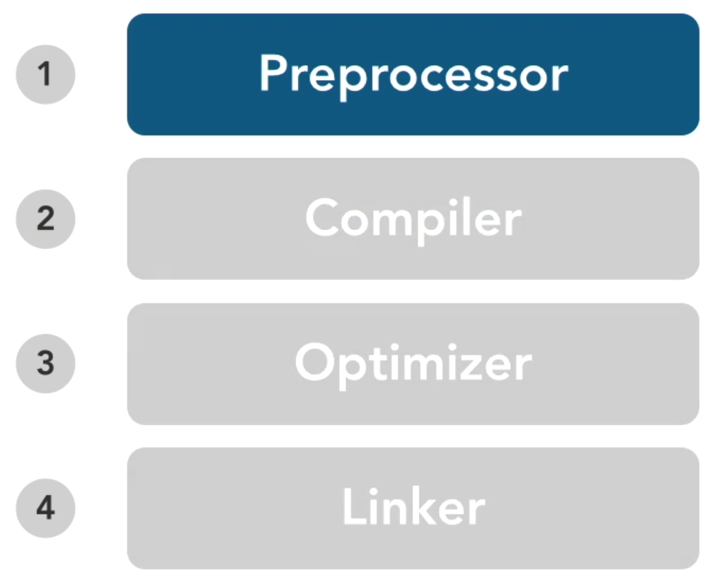
About the preprocessor
C and C++ has identical preprocessors.
Directives starts with # (sharp)
No semicolon at the end of the line.
The definition sharp must be on very first position of line.
Preprocessor run first!!!
Preprocessor do: - Includes files into source files. (#include …) - Source code string substitution ( #define …) - Condition processing – the include guard (#ifndef …) - Pragmas for a platform specific behaviour (#pragma …)

Slide 115
Using macros as constants
Heavily used especially in C.
Syntax definition: #define NAME_OF_CONSTANT value e.g.: #define ONE 1
Constants are identified by their name.
Constants names are CAPITALIZED.
Constants are substituted by pre-processor when preprocessor runs.
Constants can’t be debugged, used as variable, can get an address or point to by pointer.
Can be substituted by const type name = value definition which shows in debugger, is variable etc.

Slide 116
Including files
Includes are on very top of each source file.
Used to include header files into our source code.
Instead of massive copy/paste of header file content, we just instruct preprocessor to do so.
Preprocessor will replace #include with a header file content.
Translation unit => preprocessed source file with replaced #include directives.
Two form of directives: - <cstdio> (angle brackets – system header files) - “some_header_file.h” (quote marks – local header files, specific to project)

Slide 117
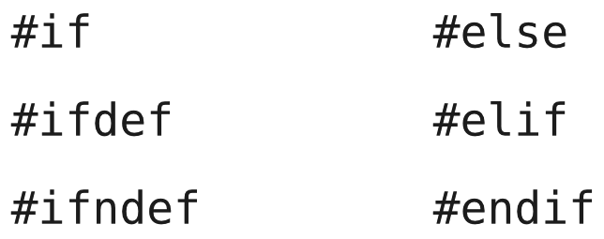
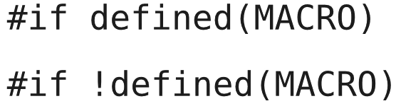
Conditional compilation
Preprocessor directives for the control flow.
Used for: - Debug - Different versions of a source code - Different platforms

Slide 118
Defining macros
Macro is a preprocessor function.
Still based on preprocessor text expansion of the source code.
Macro can be a constant (#define ONE 1) => constant. or can be variable (#define MACRO(a, b) ( a * b ) => pure variable macro.
No space between macro name and parameters!!!

Slide 119
Macro caveats and problems
No strong type control with compiler before compilation.
Macro can have unpredictable behaviour, e.g. undesired multiple evaluations.
In C++, macros should be replaced with templates.
We should use macro if and only if we really know what we are doing and how they works.

Slide 120
Line continuation with backslash
Preprocessor directive.
Enables long line wrapping.
Definition syntax: \ (backslash at the end of the line)
The backslash must be very last character on the line.
It can be used for multiline macro definitions.

Slide 121
Including files only once
Every header file must be included only once (to avoid include cycles).
Every header file must have the include guard. (#BestPractise)
Syntax definition: #ifndef SOME_UNIQUE_NAME #define SOME_UNIQUE_NAME // Some valid code #endif
Non-standard solution: #pragma once (originally from MS, but pragma directives are not standardized)

Slide 122
Chapter quiz
File inclusion is part of the? (preprocessor)
How do you declare a preprocessor constant named RECORD_COUNT with the value 1500? (#define RECORD_COUNT 1500)
How do you include a project specific header named myconstants.h? (#include "myconstants.h“)
How can you create a macro that spans multiple lines? (by terminating each line with \)
Can you use #ifndef…#define to solve the problem of including a header more than once? (Yes)

Slide 123
Tasks for practise
Try to refactor your previous programs according the C++ best practises. Move your functions to new files, create headers, place them accordingly. Test your refactored applications if they still works.

Slide 124
Working with files

Slide 125
Opening & closing & reading & writing to file
Text vs. binary format of file.
Mode of opening
Use of fopen() & fclose() for opening and closing file.
Writing => fprint() or fputs(), fwrite() for binary.
Reading => fscanf() or fgets(), fread() for binary.
FILE *fp;
char buff[255];
fp = fopen("/tmp/test.txt", "r");
fscanf(fp, "%s", buff);
printf("1 : %s\n", buff);
fgets(buff, 255, (FILE*)fp);
printf("2: %s\n", buff);
fgets(buff, 255, (FILE*)fp);
printf("3: %s\n", buff);
fclose(fp);
FILE *fp;
fp = fopen("/tmp/test.txt", "w+");
fprintf(fp, "This is testing for fprintf...\n");
fputs("This is testing for fputs...\n", fp);
fclose(fp);

Slide 126
C++ file I/O
Using standard library object fstream.
std::ofstream outfile;
outfile.open("afile.dat");// open a file in write mode.
std::cout << "Writing to the file" << std::endl;
std::cout << "Enter your name: ";
std::cin.getline(data, 100);
outfile << data << std::endl;// write inputted data into the file.
std::cout << "Enter your age: ";
std::cin >> data;
std::cin.ignore();
outfile << data << std::endl;// again write inputted data into the file.
outfile.close();// close the opened file.
std::ifstream infile;
infile.open("afile.dat");// open a file in read mode.
std::cout << "Reading from the file" << std::endl;
infile >> data;
std::cout << data << std::endl;// write the data at the screen.
infile >> data;
std::cout << data << std::endl;// again read the data from the file and display it.
infile.close();// close the opened file.

Slide 127
Practise
Define two integer variables.
Assign values to them and write the values to a file.
Try change their values directly.
Create one pointer which will points to on one of the variable.
Create one reference which will points to one of the variable.
Try to change the values of variable via pointer and via reference.
Try to print the values to console with printf(%d\n,variable) command.
Try to find out what happens when you assign a NULL to pointer and to the reference.
Try to find out what happens when you will assign the pointer to reference and vice versa.

Slide 128
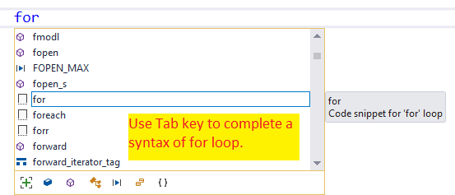
How to hack C/C++ syntax
Use IntelliSense – auto complete of your code. Start typing something and hit Tab key to complete.
Use syntax helpers on web – Cpp Reference or Cplusplus reference.
Don't try to remember the syntax. You will do a mistake eventually.
Another option is a new Microsoft Learn. Write a keyword and hit F1 button.
VS Code + CLang-format + CLandD, or C/C++ by Microsoft

Slide 129
Practise
Define two integer variables.
Try change their values directly.
Create one pointer which will points to on one of the variable.
Create one reference which will points to one of the variable.
Try to change the values of variable via pointer and via reference.
Try to print the values to console with printf(%d\n,variable) command.
Try to find out what happens when you assign a NULL to pointer and to the reference.
Try to find out what happens when you will assign the pointer to reference and vice versa.

Slide 130
OOP & OOP concepts
Notes:
Object-Oriented Programming is Embarrassing: 4 Short Examples - YouTube

Slide 131
OOP
OOP = A discipline imposed upon the use of pointers to functions (a discipline imposed upon the indirect transfer of control)
OOP was next logical step after procedural paradigm (a direct transfer of control).
Probably wrongly named and understood => true nature is polymorphism.
Derived from human perspective of the world.
Classes are OOP fundament.
The primary goal is to have small, encapsulated, atomic classes which are easy to extend, easy to reuse with small or no impact after modification.

Slide 132
OOP concepts
Classes & objects
Abstraction
Encapsulation
Composition
Delegation
Inheritance
Polymorphism
Domain modelling
SOLID

Slide 133
Functional programming

Slide 134
FP concepts
FP = a discipline imposed upon assignment
Stateless programming (without assignment operator)
Pure functions
Functions are the first-class citizens
Immutable variables
No side effects
Piping

Slide 135
FP concepts in C++
Static functions
Lambdas
New C++20 feature std::ranges:views with | (a bitwise operator) overload
std::expected – a discriminated union of two types, usually a type that represents either an expected value or an error value¹.
std::optional – an optional contained value.
std::variant – a type safe (discriminated) union
Many STL functions and concepts
MSDN Magazine
Web article

Slide 136
Classes and Objects

Slide 137
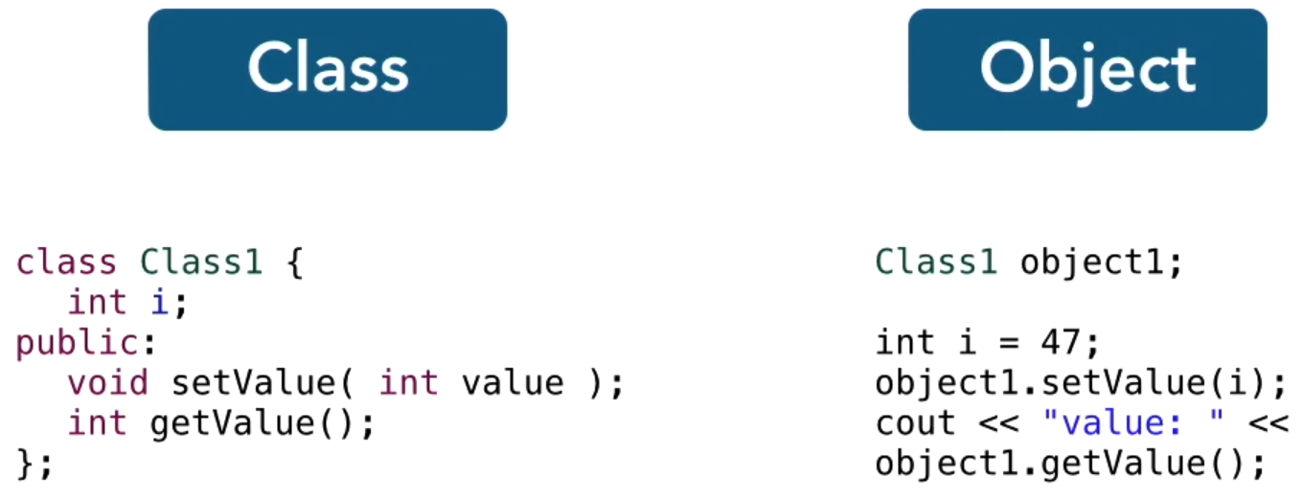
Overview of classes and objects
Classes => a custom data types.
Instance => an object of desired class.
They are formed from two types of members – data and function members.
Classes can (and often do): - Create constructors (responsible for creating an instance of the class) - Allocate and deallocate memory - Overload operators - Create conversion operators
Classes are a fundamental of OOP.

Slide 138
Defining a class
Two types of definitions: - On place - Split
Use of the split definition spreads over at least three files: - The declaration file - The definition/implementation file - A file with usage of the class
Syntax used in implementation uses “::” operator.
BTW: What the hell is struct? Struct is a structure and it isn’t very popular in C++ because it is almost same as class, see here.

Slide 139
Data members
Elements selection operator “.”
Pointer selection operator “->” (used when we are pointing to our class, and we want to access the members).
References uses a dot operator.
Better to encapsulates the access to method calls. (#BestPractise)

Slide 140
Function & Operator members
Function member => a function which belongs to class.
Often referred to as “method”.
Methods are often used for accessing private data members – encapsulation with a getter and a setter.
Methods can be marked (or overloaded) as const which is necessary with constant object interaction.
Operators are just another type of methods.

Slide 141
Lvalue vs. rvalue (left-hand-value vs right-hand-value)
So finally, what is a Lvalue? What the big fuzz about?
Lvalue: - Expression that refer to a memory location is called “lvalue” expression. A lvalue may appear as either the left-hand or right-hand side of an assignment.
Rvalue: Not a lvalue (can be on the right-hand-side of assignment).
Examples (more types here and here): int a = 4; // 4 – right hand value, you can’t assign int a to 4 on the left, right? 4 = int a; // Make no sense. a = Func(); // Make perfect sense, a is lvalue. int b = a; // Still make sense, right? Func() = a; // Ehm, does this make sense?

Slide 142
Constructors and destructors
Constructors and destructors are special class methods.
A constructor has same name as class, a destructor has ~ in addition.
Invoked in specific situations.
Constructors are used to fully construct an instance of the class.
Destructors are used to a full clean-up when instance has no further use.
Class always has a default constructor and destructor (created by a compiler).
Initializers can be used within constructor call.
Move constructor => A C++11 feature to address some performance issues
Private default (empty) constructor => prohibits from constructing an instance without any input parameters.

Slide 143
Constructors and destructors syntax
#include <iostream>
using namespace std;
class MyClass { // The class
public: // Access specifier
MyClass() { // Constructor
cout << "Hello World!";
}
~MyClass() { // Destructor
cout << "Goodbye World!";
}
};
int main() {
MyClass myObj; // Create an object of MyClass (this will call the constructor)
std::cout << std::endl;
return 0;
} // Destruction of the MyClass object (this will call the destructor)
Hello World!
Goodbye World!

Slide 144
Constructor types
Default constructor => generated by a compiler when no constructor provided
Implicit constructor => any compiler generated constructor (e.g., a copy constructor)
Parametrized constructor => a constructor with parameters
Copy constructor => used to copy an object T to another object T
Move constructor => a memory performance optimalization
Private default (empty) constructor => prohibits from constructing an instance without any input parameters.
Explicit constructor => a constructor with keyword explicit
Converting constructor => a non-explicit constructor with a single parameter
Magic rule – the rule of three (or five, or zero, or here). Some criticism of rule of zero here.

Slide 145
Copy constructor syntax
class Point {
private:
int x;
int y;
public:
Point(int x1, int y1)
{
x = x1;
y = y1;
}
// Copy constructor
Point(const Point& p1)
{
x = p1.x;
y = p1.y;
}
int getX() { return x; }
int getY() { return y; }
};
// Copy constructor T(const T & t) {…}

Slide 146
Move constructor syntax
class Point {
private:
int x;
int y;
public:
Point(int x1, int y1)
{
x = x1;
y = y1;
}
// Move constructor
Point(const Point&& p1)
{
x = p1.x;
y = p1.y;
}
int getX() { return x; }
int getY() { return y; }
};
Used by compiler on temporary objects
Be aware of useless implementations due to std::move
// Move constructor
T(const T && t) {…}

Slide 147
Copy assignment operator
Used whenever selected by overload resolution, e.g., when an object appears on the left side of an assignment expression.
T & T::operator=(T) {…} // Copy assignment operator
T & T::operator=(const T & t) {…} // Copy assignment operator

Slide 148
Move assignment operator
Used when an object appears on the left-hand side of an assignment expression, where the right-hand side is a rvalue of the same or implicitly convertible type.
Performance optimalization (no copy of rvalue)
T & T::operator=(T &&) {…} // Move assignment operator

Slide 149
Comparision
One more time…
T(const T & t) {...} // Copy constructor
T(const T && t) {...} // Move constructor
T & T::operator=(T) {…} // Copy assignment operator
T & T::operator=(const T & T) {…} // Copy assignment operator
T & T::operator=(T &&) {…} // Move assignment operator
Notes:
Vytvořte si vlastní třídu.
V třídě si vytvoře konstruktor, který vytiskne na obrazovku hlášení, že se volá konstruktor.
V třídě si vytvoře destruktor, který vytiskne na obrazovku hlášení, že se volá destruktor.
V třídě si vytvoře copy konstruktor, který vytiskne na obrazovku hlášení, že se volá copy konstruktor.
V třídě si implementujte copy asssignment operátor, který vytiskne na obrazovku hlášení, že se volá tento operátor.
V funkci main několik instancí na stacku.
Tuto instanci přiřaďte do nějaké nově vytvořené instance.
Pomocí operátoru new ... vytvořte novou instanci na heap,
pak si nad touto instancí zavolejte delete.
Vytvořte funkci, která přebírá instanci Vaší třídy a uvnitř vytváří novou instanci třídy a tu vrací volajícímu.

Slide 150
Comparision
Code samples…
Point p1 = {0, 1}; // Implicit constructor + move assignment operator call (from rvalue temporary)
Point p2 = p1; // Copy assignment operator
Point p3(p1); // Copy constructor
Point p4({0, 1}); // Implicit + Move constructor
Notes:
Vytvořte si vlastní třídu.
V třídě si vytvoře konstruktor, který vytiskne na obrazovku hlášení, že se volá konstruktor.
V třídě si vytvoře destruktor, který vytiskne na obrazovku hlášení, že se volá destruktor.
V třídě si vytvoře copy konstruktor, který vytiskne na obrazovku hlášení, že se volá copy konstruktor.
V třídě si implementujte copy asssignment operátor, který vytiskne na obrazovku hlášení, že se volá tento operátor.
V funkci main několik instancí na stacku.
Tuto instanci přiřaďte do nějaké nově vytvořené instance.
Pomocí operátoru new ... vytvořte novou instanci na heap,
pak si nad touto instancí zavolejte delete.
Vytvořte funkci, která přebírá instanci Vaší třídy a uvnitř vytváří novou instanci třídy a tu vrací volajícímu.

Slide 151
Path to Copy elision
Let's have a look on this code: https://onlinegdb.com/-4PrGwMPc Follow the tasks
Notes:
https://youtu.be/IZbL-RGr_mk?si=rY3-ybBcYl9eFM4B&t=57 // Task 1: Would you would see if the main gets executed.
// Task 2: Verify that you were correct. (or not)
// Task 3: Compile the code with flags: -O0 -std=c++11 (O = optimization 0 = none)
// Task 4: Compile the code with flags: -O0 -std=c++11 -fno-elide-constructors
// Task 5: Can you identify what have changed and from where are the messages omitted?
// Task 6: Take the code from main2 file and compile it with -O0 -std=c++11
// Task 7: Take the code from main2 file and compile it with -O0 -std=c++17
#include <iostream>
#include <utility>
struct S {
int x;
explicit S(int x) : x{x} { std::cout << "construct S(" << x << ")\n"; }
S(const S& other) : x{other.x} { std::cout << "copy S(" << x << ")\n"; }
// S(const S& other) = delete;
// S(S&& other) : x{other.x} { std::cout << "move S(" << x << ")\n"; }
// S(S&& other) = delete;
};
S make_value(int x) {
// URVO (Unnamed return value optimization, guaranteed in c++17)
// Comment other code,
// delete the copy constuctor switch to C++17, call this method from the main
// see what happens.
return S(S(S(S(x))));
}
S make_double_value(int x) {
// NRVO (named return value optimization, not guaranteed)
S s = make_value(x);
s.x = 2 * x;
return s;
}
S no_elision(int x) {
S s1(x);
S s2(x);
if (x > 0) {
return s1;
} else {
return s2;
}
}
S maybe_elision(int x) {
// compiler can elide, clang and msvc do, gcc does not
if (x > 0) {
S s1(x);
return s1;
} else {
S s2(x);
return s2;
}
}
int main() {
S s = make_double_value(21);
std::cout << "answer: " << s.x << '\n';
return 0;
}

Slide 152
Copy elision – RVO (URVO/NRVO)
Copy elision is certain compiler memory optimization behaviour by deferred materialization of an object.
Compilers tend to construct an object in the storage of the object’s final destination in order to minimize copy/move operations.
Copy elision = The compiler is allowed to elide copies where results are “as if” copies were made.
Copy elision with “allocation elision and extension” are only two allowed optimization that can have observable side effects.
That is why we don’t want to have any side effects in copy constructors!
Copy elision is just a generic name for two behaviours: (Un)Named Return Value Optimization
Present in C++11, but since C++17 behaviour changed.
Notes:
https://youtu.be/IZbL-RGr_mk?si=rY3-ybBcYl9eFM4B&t=57

Slide 153
Unnamed Return Value Optimization (UNRVO)
Mandatory in C++17 (no matter if an object has copy constructor)
On return statement when the operand: - is a nameless temporary and - the object’s class type matches the return type and - a non-volatile object and - automatic storage duration and - non-functional parameter or - a catch clause parameter
Notes:
https://youtu.be/IZbL-RGr_mk?si=rY3-ybBcYl9eFM4B&t=57

Slide 154
Named Return Value Optimization (NRVO)
On return statement when: - the operand has a name and - the object’s class type matches the return type and - a non-volatile object and
std::string getGreeting()
{
return std::string("Hello, world!");
}
Notes:
https://youtu.be/IZbL-RGr_mk?si=rY3-ybBcYl9eFM4B&t=57

Slide 155
Object initialization
Can be sometimes hard (and complicated, especially on definitions).
We have several different types of initializations… Value initialization std::string s{}; // Empty initializer Direct initialization std::string s("hello"); // Explicit ctor Copy initialization std::string s = "hello"; // From object List initialization std::string s{'a', 'b', 'c'}; // A list Aggregate initialization char a[3] = {'a', 'b'}; // Another list Reference initialization char& c = a[0]; // A simple reference

Slide 156
Task for practice
Design a simple class with all the constructors and assignment operators.
The class will take some identifier to uniquely identify the instance of the class.
Implement all the logic with printout statements on console with following logic: “Constructing the object {name_given_in_constructor}” “Deleting the object {…}” etc.
Test the logic of the class. (Create an instance of the class on stack, heap, call delete on heap instance, create a function that takes your class as parameter and returns an instance of the same type. Watch what happens in the output window.)

Slide 157
Implicit vs. explicit constructors
Implicit conversion happens when an object is assigned to constructor and no appropriate constructor is found.
The keyword explicit prohibits the implicit conversion from happening.
With explicit conversion, assignment expression isn’t possible StrSize s = "x"; vs StrSizeAdvanced ss("x");
Again – one of the aspects which one must remembers when designing an application.
class MyClass {
int i;
/*implicit*/ MyClass(int i) : i(i) {}
}
int main() {
MyClass clz = 2;
}
class MyClass {
int i;
explicit MyClass(int i) : i(i) {}
}
int main() {
MyClass clz = MyClass(2);
}

Slide 158
Namespaces
Solves the name conflict problem (but creates another problem – a unique cascade of namespaces).
They can be nested into each other.
Namespace cascade should be unique, meaningful and representative for its actual use.
Operator “::” enables navigation between namespaces.
We can shortcut the full qualification by: - Adding a using namespace statement (using namespace Demo;) - Adding a using with full name (using Demo::MyClass;), a namespace prefix is omitted in this case.
Let’s see some syntax.

Slide 159
Namespaces – example
#include <iostream>
#include "TestClass.h"
void SomeFunction()
{
using namespace Eaton;
OutsideOfTheNamespace();
Client();
SPI();
Microcontroller::SPI();
Utilities::SomeUtility();
SomeFunction2();
}
void SomeFunction2()
{
OutsideOfTheNamespace();
using namespace Eaton::Microcontroller;
// Client(); // <- Not accesible here due to nesting in namespaces.
SPI();
}
int main()
{
OutsideOfTheNamespace outside();
Eaton::Client client();
Eaton::SPI spi();
Eaton::Microcontroller::SPI();
Eaton::Utilities::SomeUtility();
}
#pragma once
namespace Eaton
{
class Client{};
namespace Utilities
{
class SomeUtility{};
}
inline namespace Microcontroller
{
class SPI{};
}
}
class OutsideOfTheNamespace{};

Slide 160
Unnamed Namespaces
Translation unit-scoped namespace TODO
namespace
{
int i; // defines ::(unique)::i
}

Slide 161
Pointing to the current object with *this
The keyword this => pointer (!!!) to the current object.
This pointer gives us the address of the current object within the class (methods body).
Useful for: - Overloading of assignment operators - Checks etc.
Every method call has implicit this operator embedded to its call.

Slide 162
Overloading operators with nonmember functions
Solves the problem of operator interaction with unknown combination of operands, e.g., literal and our class (our class is right-hand-side operand, see the next slide).
We can teach someone else classes to new behaviour.
The most user case is overload with std::cout.
Some useful note with the best solution about std::cout.
Some operators can’t be overloaded by non-member functions. (::, =, [], (), ->, ., typeid, sizeof can’t)
std::ostream& operator<< (std::ostream &out, const Point &point);

Slide 163
Overloading operators with member functions
C++ has a unique and powerful system of the operator overloading.
We already know the non-member function overload of the operator; member overload is similar.
We use prefix of the class T::, remove the left most parameter and replace by this)
friend std::ostream& operator<< (std::ostream &out, const Point &point);

Slide 164
Overloading operators with (non) member function
See notes on this slide.
std::ostream& operator<< (std::ostream &out, const Point &point);
friend std::ostream& operator<< (std::ostream &out, const Point &point);
Notes:
#include <iostream>
using namespace std;
class Complex {
private:
int real, imag;
public:
Complex(int r = 0, int i = 0) {
real = r;
imag = i;
}
// Overloading operator + using member function
Complex operator+(Complex const &obj) {
Complex res;
res.real = real + obj.real;
res.imag = imag + obj.imag;
return res;
}
};
// Overloading operator + using non-member function
Complex operator+(Complex const &obj1, Complex const &obj2) {
Complex res;
res.real = obj1.real + obj2.real;
res.imag = obj1.imag + obj2.imag;
return res;
}
int main() {
Complex c1(10, 5), c2(2, 4);
Complex c3 = c1 + c2; // Member function
Complex c4 = c1 + c2; // Non-member function
cout << "Using member function: " << c3.real << " + i" << c3.imag << endl;
cout << "Using non-member function: " << c4.real << " + i" << c4.imag << endl;
return 0;
}
class MyClass {
public:
MyClass(int x) : x_(x) {}
friend std::ostream& operator<<(std::ostream& os, const MyClass& obj) {
os << "MyClass(" << obj.x_ << ")";
return os;
}
private:
int x_;
};
class MyClass {
public:
MyClass(int x) : x_(x) {}
private:
int x_;
};
std::ostream& operator<<(std::ostream& os, const MyClass& obj) {
os << "MyClass(" << obj.x_ << ")";
return os;
}

Slide 165
Conversion operators
The final type of operators (for overloading).
When we try to merge our class with other type, a conversion operator is used.
Definition syntax: operator Type_to_convert_to const; operator std::string() const;
We can define as many conversion operators as we need.

Slide 166
Stack allocation
Automatically released when out-of-scope – RAII, discussion
Freeing of stack memory is cheap.
Dynamic allocation on stack – alloca(...)
Or just use vector<T>
int main()
{
// All these variables get memory
// allocated on stack
int a;
int b[10];
int n = 20;
int c[n];
}

Slide 167
Creating and destroying objects with new and delete
The keywords new/delete are operators.
They instruct compiler generate instructions for a heap memory allocation or a deallocation.
Allocation => new.
Deallocation => delete.
We must never lose a reference to a memory created by new operator!!!!!!!!!!!!!!!!!!!!!!!!!!!!!!!!!!!!!!!!!!!!!!!!!!!!!!!!!!!!!!!!!!!!!!!!!! Memory leak otherwise.
Call of new operator => a delete call operator.
Call of new operator in constructor => a delete call operator in destructor.
Interesting talk about resources and garbage collection.

Slide 168
Creating function objects (functors)
Functor => an overloading of operator ().
A class could work like a function.
User cases: - Keeping state. - Keeping context information during a function call.
Some further reading about functors.

Slide 169
Example with cars
See notes in this slide.
Various use of namespaces, pointers, creation of new class objects etc.
Notes:
#include <stdio.h>
#include <iostream>
#include <string>
#include <cstring>
namespace Vehicle
{
namespace Cars
{
class Car
{
unsigned int _power;
unsigned int _engineVolume;
public:
Car(unsigned int power, unsigned int engineVolume)
{
std::cout << "This is a car constructor" << std::endl;
_power = power;
_engineVolume = engineVolume;
}
unsigned int GetPower()
{
return _power;
}
unsigned int GetEngineVolume()
{
return _engineVolume;
}
};
class Suv : public Car
{
public:
Suv(unsigned int power, unsigned int engineVolume) : Car(power,engineVolume)
{}
};
class Sedan : public Car
{
public:
Sedan(unsigned int power, unsigned int engineVolume) : Car(power,engineVolume)
{}
};
}
namespace Motocycles
{
class Motocycle
{
};
}
}
int main()
{
Vehicle::Cars::Suv suv(160,3000);
std::cout << "The power of this is: " << suv.GetPower() << std::endl;
Vehicle::Cars::Car * someCar = new Vehicle::Cars::Sedan(80,1600);
std::cout << "The power of this is: " << someCar->GetPower() << std::endl;
Vehicle::Cars::Car array[2] = {Vehicle::Cars::Suv(250,4000), Vehicle::Cars::Sedan(100,2000)};
for (int i = 0; i < 2; i++)
{
Vehicle::Cars::Car someCar = array[i];
std::cout << "The power of this is: " << someCar.GetPower() << std::endl;
}
return 0;
}

Slide 170
Chapter quiz
How do you write a destructor for the class Employee?(~Employee())
How can you access the public data member length in the Rectangle structure using a pointer named pRect? (pRect->length)
What do you use to cause an exception to happen in your program? (throw)
What is a correct declaration for overloading the function operator?? (int operator () (int x) const {...})
Where a new operator call allocate memory? (heap)

Slide 171
Tasks for practise
Create a program which will have a simple database of employees in your company. Model a single employee with appropriate class. Print a menu where user can create, delete, display details and quit. Populate the database with you and a few of your colleagues.
Modify previous program for a book catalogue.
Make a simple tic-tack-toe game for two players, 3x3 grid. User 1 will start. Use ‘X’ and ‘O’ marks. Ask if players want to have a rematch. If so, the other player will start (players will alter after each game).

Slide 172
Error handling

Slide 173
Exceptions
Used for reporting unexpected errors.
Syntax definition: try {// some code which can throw an exception} catch (const excptType & e) {// some meaningful reaction}
We fire exceptions by the keyword throw throw std::invalid_argument("received negative value");
Exceptions are also classes. You can make your own.
Catching order => From the most exotic to the most general.
Some common mistakes to avoid, some best practise about exception handling.

Slide 174
When to throw
I/O operation with hardware - Connecting, reading, writing to any port, or similar.
Anything related to networking
Any operation on file system
Operations with databases
Division
Memory range access
Type overflow - Int32_t maxValue++;
Input validation - Any value given from user, or any source of problems (int someNumber = GetValueFromHTMLForm();

Slide 175
Some notes about exceptions
Never ever throws std::exception, make your own, specific exceptions.
Do not reinvent the wheel – list of std exceptions
Always try to throw most specific exceptions.
Exceptions have cost => prevent the exceptions on the first place.
Useful for complex call stacks where happy path takes too much effort (code).
Correctness vs. performance
Fail fast, fail early (Chuck Norris colour in HTML parsers => robustness? 🤔)

Slide 176
Stack unwinding
Clearing of resources in reverse orders.
The control flow logic goes from up to bottom in the call stack until it finds some try/catch block. The logic calls destructors along the way. If no appropriate catch block is found, the logic continues in the call stack.
If exception occurs in a try block, everything in the try block is destructed.
If exception occurs in a block of code (not within the try block), everything in the block of code gets destroyed.
RAII automatically release the resources, no need for manual clean up.

Slide 177
Keyword noexcept
Instruction for compiler to optimize.
In reality, it should be considered as “won’t throw an exception worth catching”.
Application is terminated when exception is thrown from a function with noexcept.

Slide 178
Task for practice
Design your exception derived from std::exception
Design a simple console application which calculates a division of two given numbers.
The application will tolerate three catastrophic failure of the subsequent logic.
The application will show in console what was wrong.
The fourth failure will terminate the application completely.

Slide 179
Standard library

Slide 180
Overview of the Standard Library
Non separable part of C++ tooling.
STL is just obsolete & confusing name for a part of the library included in the Standard library, see Standard Template Library.
Developed side by side with C++ itself.
A collection of generic containers, functions to manipulate with containers, function objects, generic strings, smart pointers, streams and other stuff.
The golden rule of C++: If you can solve it by something in std::, do it. If you can’t solve it by something in std::, try it again.
Don’t forget on the C++ version dialect

Slide 181
Remarks about VS solution settings & standard code
C++ SL specification isn’t quite specific about certain things => troubles with implementations.
Solution Properties -> C/C++ -> Preprocessor definition -> RMB -> Edit: _CRT_SECURE_NO_WARNINGS _HAS_ITERATOR_DEBUGGING=0
(1) disable warnings generated by CRT because of it has its own STL containers & functions
(2) MS has a specific iterator implementation which varies from others => settings for portable standard code.

Slide 182
Smart pointers from Standard Library

Slide 183
Smart pointers
Stack allocated pointers for heap allocated objects.
Memory is released automatically when the smart pointer is released.
void my_func()
{
int* valuePtr = new int(15);
int x = 45;
// ...
if (x == 45)
return; // here we have a memory leak, valuePtr is not deleted
// ...
delete valuePtr;
}
int main()
{
}

Slide 184
std::unique_ptr<T>
Since C++11 primary smart pointer in C++.
The second, improved, without-flaws iteration of smart point implementation.
Holds object created by new, or new[].
A single owner.
Delegated to make_unique<T>, where we can pass arguments directly.
You can provide your own delete function.
You can only move the pointer (the ownership).
std::unique_ptr<int> valuePtr(new int(47));
auto ptr = std::make_unique<int>(new int(47));

Slide 185
std::shared_ptr<T>
#include <memory>
class Foo
{
public void doSomething();
};
class Bar
{
private:
std::shared_ptr<Foo> pFoo;
public:
Bar()
{
pFoo = std::shared_ptr<Foo>(new Foo());
}
void Check(){pFoo->doSomething()};
std::shared_ptr<Foo> getFoo()
{
return pFoo;
}
};
A reference counting smart pointer.
Designed to more than one owner scenarios.
Often created by std::make_shared.
Another good example.

Slide 186
Std::shared_ptr<T>
void SomeAction()
{
Bar* pBar = new Bar(); //with the Bar object, a new Foo is created and stored
//reference counter = 1
std::shared_ptr<Foo> pFoo = pBar->getFoo(); //a copy of the shared pointer is created
//reference counter = 2
pFoo->doSomething();
delete pBar; //with pBar the private pFoo is destroyed
pFoo->Check();
//reference counter = 1
return; //with the return the local pFoo is destroyed automatically
//reference counter = 0
//internally the std::shared_ptr destroys the reference to the Foo object
}

Slide 187
std::weak_ptr<T>
Complementary addition to std::share_ptr<T>
Provides a non-owning reference to an object that is managed by a shared pointer.
Provides a way to access the managed object of a shared pointer without extending its lifetime.
Breaks circular references (an object A points to object B and vice versa)
std::shared_ptr<int> sharedPtr(new int(42));
std::week_ptr<int> ptr = sharedPtr;

Slide 188
std::*_ptr<T> vs. std::make_*<T>
Make_* is more memory leak safe.
Make_* no duplicate writing. unique_ptr<T>(new T()) -> make_unique<T>()
Don't use make_unique if you need a custom deleter or are adopting a raw pointer from elsewhere.
void function(std::unique_ptr<A>(new A()), std::unique_ptr<B>(new B())) ​
{ // a silent memory leak upon failure of first ctor call }​
void function(std::make_unique<A>(), std::make_unique<B>()) { // safe }​

Slide 189
Thread safe smart shared pointers
Modifying reference counter is thread safe, accessing resources not.
To access a resource held by share_ptr, we need atomic share pointer.
Since C++20, we use std::atomic as wrapper around thread-safe accessing.
#include <atomic>
#include <memory>
int main() {
std::atomic<std::shared_ptr<int>> ptr;
ptr.store(std::make_shared<int>(42));
std::shared_ptr<int> p = ptr.load();
return 0;
}

Slide 190
Exercise
Create a function that takes a unique pointer to numeric values.
Do a sum of those numeric values.
Return a unique pointer to the result of those values.
std::unique_ptr<int> valuePtr(new int(47));
auto ptr = std::make_unique<int>(new int(47));

Slide 191
Lambdas

Slide 192
What is lambda?
Anonymous function generated by compiler
An expression which holds some code.
The lambda function has overloaded () operator by a compiler.
[](){} ⬅a valid lambda 🤷🏿‍♀️
auto isEven = [](int candidate) {return candidate % 2 == 0; };

Slide 193
Why lambda?
For generic programming
For functional programming
For concurrency
Readability (no joke) (eliminates function pointers which are hard to read and write)

Slide 194
Lambda syntax
Mandatory auto
Name of lambda (a variable which hold the lambda expression)
[ ] capture clause (makes variables from calling scope available inside the lambda body)
( ) input arguments to lambda body
{ } lambda body
auto isEven = [](int candidate) {return candidate % 2 == 0; };
vector nums {2,3,4,-1,1};
int evens = std::count_if(begin(nums), end(nums), isEven);

Slide 195
The lambda capture clause
By default, member variables are const (finally!)
[ ] captures nothing, lambda uses only function parameters
[x, y] captures x and y by value
[&x, &y] captures x and y by reference
[&x, y] captures x by reference, y by value
[x = a+1, y = std::move(b)] alias and move capture
[=] all in! copy of everything
[&] all in! as reference
[=, &x] captures x by reference, everything else by value
[&, x] captures x by value, everything else by reference
Mutable => allows lambda to change capture references
Static variables are captured by reference (as default ??? 🤔)

Slide 196
Mutable
By default, member variables are const
Mutable => allows lambda to change capture references
Lambda requires mutable because by default, a function object should produce the same result every time it's called
#include <iostream>
int main()
{
int n;
[&](){n = 10;}(); // OK
[=]() mutable {n = 20;}();// OK
// [=](){n = 10;}(); // Error: a by-value capture cannot be modified in a non-mutable lambda
std::cout << n << "\n"; // "10"
}

Slide 197
The lambda vs. function pointers
#include <iostream>
using namespace std;
int add(int x, int y){return x + y;}
int main()
{
// Function pointer declaration
// for a function having int as
// return type and two int parameter
// Evolution of function pointers int (*funptr1)(int, int) = add;
auto funptr2 = add;
// Calling the function pointer
int x = funptr1(4, 6);
int y = funptr2(4, 6);
cout << x << endl;
cout << y;
return 0;
}
Lambda is an easy-to-use replacement for function pointers.
Not all cases make sense for lambdas.
Ugly C-like function pointers can be replaced by smart function pointers with auto.
Lambdas are supported by SL.

Slide 198
Exercise
Define a vector of a vector of int.
Set random values to these vectors.
Create a lambda to calculate a sum of all elements inside the vectors.
auto isEven = [](int candidate) {return candidate % 2 == 0; };

Slide 199
Object inheritance

Slide 200
Inheritance - terminology
Super class, ascendant, base class => a class from which we are deriving from.
Derived class, descendant, child class => A class which the functionality is derived to.

Slide 201
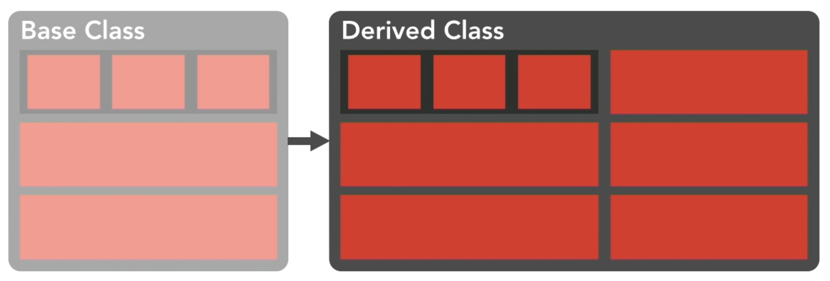
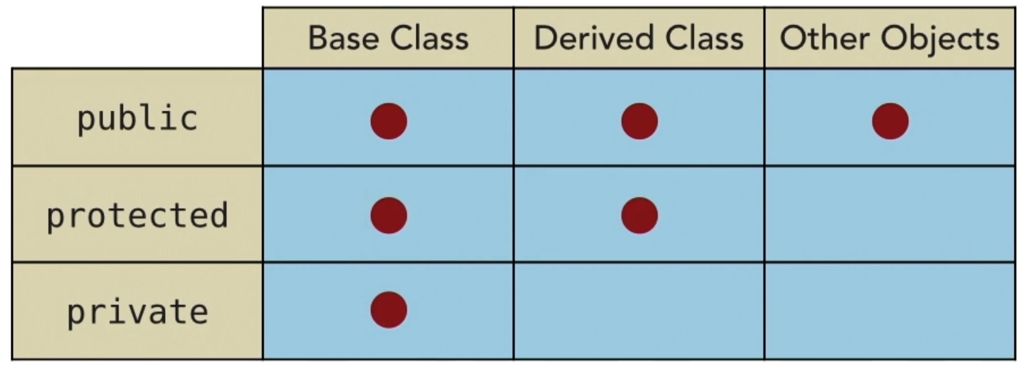
Simple inheritance
Enables a sharing or ensuring of functionality (members and methods) between classes. One class derives from another.
Base class => A class from which the functionality is derived from.
Derived class => A class which the functionality is derived to.
Members and methods have access modifiers for a protection in inheritance process.

Slide 202
Accessing the base class
class Mother {
public:
Mother ()
{ cout << "Mother: no parameters\n"; }
Mother (int a)
{ cout << "Mother: int parameter\n"; }
};
class Daughter : public Mother {
public:
Daughter (int a)
{ cout << "Daughter: int parameter\n\n"; }
};
A base class constructor => from a constructor of derived class.
Access operator “::” to identify which member we are accessing. It also solves name conflicts.
Provides an access method rather direct accessing even for derived class.

Slide 203
Friendship
A breaking of an encapsulation and inheritance for specific classes which are marked with friend in a base class.
The keyword friend could be also applied to a method declaration. This method (from other class) has access to even private member.
Example use => the std::cout operator << override with user classes.
class Node {
private:
int key;
Node* next;
/* Other members of Node Class */
// Now class LinkedList can
// access private members of Node
friend class LinkedList;
};

Slide 204
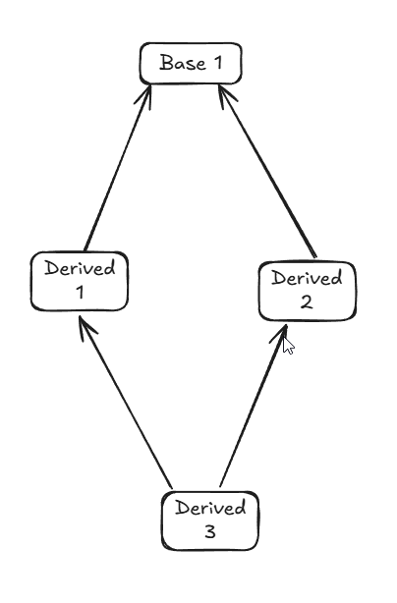
Multiple inheritance
Listing more than one class in class definition.
Listing is separated by comma.
We can define different type of inheritance (public vs. protected)
The diamond problem Solution => Virtual inheritance, or composition.
class Rectangle: public Polygon, public Output;
class Triangle: public Polygon, public Output;
class Rectangle: virtual public Polygon, virtual public Output;
class Triangle: virtual public Polygon, virtual public Output;

Slide 205
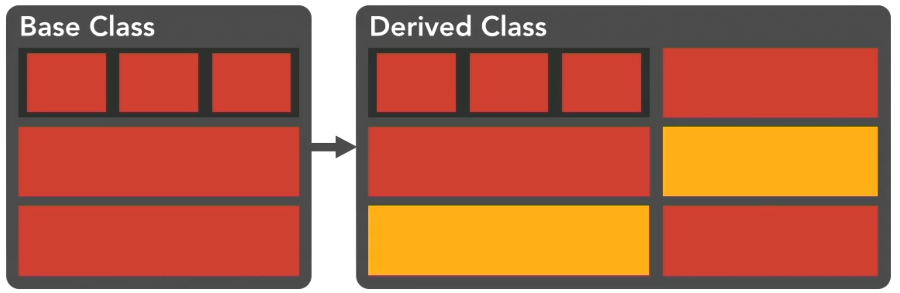
Overloading methods and exploring polymorphism
A derived class could override the behaviour of a base class.
Overloading a method in a derived class with same signature as in a base class, will cause the overloading of the method.
The keyword virtual => instructs a compiler to prefer overloaded methods in pointer-to-base-class calls.
Any virtual method? => Virtual destructor!!! (#BestPractise)

Slide 206
Memory stacking with inheritance
Inheritance is essentially stacking subclasses on top of base classes in the memory.
Members are stacked in memory from top-to-bottom (very first member is on the bottom on the stack).
struct Complex
{
float real;
float imag;
};
struct Derived : public Complex
{
float angle;
}
struct Derived
{
struct Complex
{
float real;
float imag;
};
float angle;
}
==

Slide 207
Chapter quiz
Which access specifier do you use when the member is accessed only in the base class? (private)
What a best practice with an access to the private members of the base class? (provide accessor methods to access them)
How do you declare that the class HourlyEmployee takes the functionalities from the classes Employee and Vacation? (class HourlyEmployee : public Employee, Vacation {} )
In order to get the compiler to use the overloaded version of a method, you can declare the base class version of the method as? (virtual)

Slide 208
Abstraction

Slide 209
Principle of abstraction
Common confusion with inheritance.
Primary goal is the black box functionality behaviour.
We are talking about data & behaviour abstraction.
Class should behave consistently no matter what data is provided.
Closely relates with delegation.

Slide 210
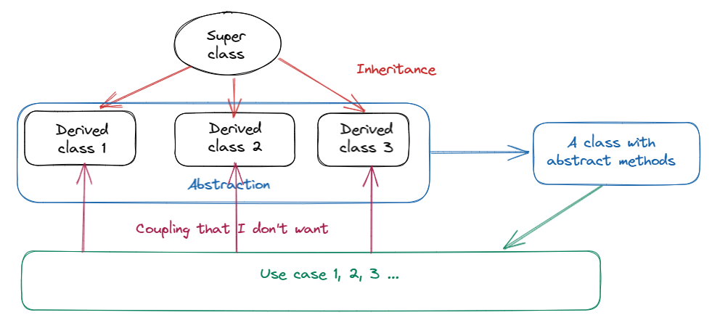
Abstraction vs. Inheritance

Slide 211
Abstract class

Slide 212
Principle of abstract class
Implementation of interface-like feature => contract: What-How.
Describes the behaviour or capability of a class without any implementation.
Abstract class => at least one pure virtual function: virtual int GetId() = 0;
// Base class
class Shape {
public: // pure virtual function providing interface framework.
virtual int getArea() = 0;
void setWidth(int w) { width = w; }
void setHeight(int h) { height = h; }
protected:
int width; int height; };
// Derived classes class Rectangle: public Shape { public: int getArea() { return (width * height); } };

Slide 213
The composition principle
#include <iostream>
using namespace std;
class Engine {
public:
void start() { cout << "Engine started!" << endl; }
};
class Wheels {
public:
void rotate() { cout << "Wheels are moving!" << endl; }
};
// Instead of inheriting from both Engine and Wheels, we use composition
class Car {
private:
Engine engine;
Wheels wheels;
public:
void drive() {
engine.start();
wheels.rotate();
cout << "Car is moving!" << endl;
}
};
int main() {
Car myCar;
myCar.drive();
return 0;
}
An alternative implementation of interface-like feature => contract: X has a ...
We compose higher functionality from the inner fields.
Gets overhelming in the complex models.

Slide 214
Polymorphism

Slide 215
Principles of polymorphism
Calling same method with different implementation.
Contract: What-How, commonly via interface.
Interface in C++ => abstract classes.
Method overloading => one method, variation of parameters.
Parametric polymorphism => template => same function, different parameter types.
Operator overloading based on operand type.
Dynamic linking via virtual functions in runtime (compare with static in compilation => function overloading).

Slide 216
Polymorphic class

Slide 217
Principle of polymorphic class
We use two keyword virtual and override to drive what is called in runtime.
virtual => an instruction for compiler to create virtual table.
override => an instruction for compiler to do some sanity check. (Is there any method to override?)
virtual table => a table with pointers to functions.
If child class defines a same method as a base class which is virtual, the method in derived class gets written to virtual table.
Never call virtual methods inside the constructor (you are inside the base class; no override method is actually called)

Slide 218
Sanity check 🤔
You have to remember to use override
In reality, not really helpful and poorly designed.
struct Base
{
virtual int foo() const {};
};
struct Derived : Base
{
virtual int foo() override // compilation error
{
// I must add const after foo() to make // compiler happy.
}
};
struct Base
{
virtual int foo() const {};
};
struct Derived : Base
{
virtual int foo() // whoops!​
{
// ... Where is my const?​
}
};

Slide 219
Templates

Slide 220
Understanding templates
Provides a support for a generic (meta) programming.
We have template functions, methods, classes.
The template keyword will instruct a compiler to issue a every version of the template function which is necessary.
Larger binaries, debugging is more challenging, longer compile times, more sensitive for error.
The biggest pitfall of templates are error messages.

Slide 221
Template syntax
Template function syntax is almost same as a function; we just add a new line above – template <type_name T> and use the T like a variable.
Template method syntax follows the template function, just the line is on top top class.
Template class is decorated by template <class T>
template <typename T>
class MyClass {
public:
void myMethod(T arg) {
cout << "The argument is: " << arg << endl;
}
};

Slide 222
Template functions
Replacing weak type security with preprocessor macros.
Information about general type is added to function definition.
Compiler generates appropriate binary code for each particular variant of code.
template <class myType> myType GetMax (myType a, myType b) { return (a>b?a:b); }

Slide 223
Template classes
Class can have a member with unknown type.
#include <iostream>
template <class T>
class mypair {
T a, b;
public:
mypair (T first, T second){a=first; b=second;}
T getmax ();
};
template <class T>
T mypair<T>::getmax () {
T retval;
retval = a>b? a : b;
return retval;
}
int main (){
mypair <int> myobject (100, 75);
mypair<double> myfloats (3.0, 2.18);
Std::cout << myobject.getmax();​
return 0;
}

Slide 224
Type inference
Here we go.

Slide 225
Debugging of template
Use typeid(T).name() with cout
Use metashell
Use cppinsights.io
Use static_assert
Use sandboxes – write a small, sandboxed code against your templates.
Use concepts to clear up the error messages, see next slides.
Use cheat sheet for the 2nd occurrence of any error you come across.
Avoid syntax like return some_method(val) /100.0 but prefer T val_ = some_method(val); return val_ / 100.0;

Slide 226
Type traits
Allow us to obtain information about types at compile time.
A typical task involes: - Checking a type if is it integral type, a floating-point type - Transforming types (adding, removing qualifiers like const or volatile), removing references, decay to underlying type in type inheritance - Finding common type of two types, finding the unum type, finding the result type of a function, etc. - Enabling/Disabling certain code based on the types of the template, e.g., std::enable_if
Usually implemented as template with static member constant „value“ that holds the result of the trait, e.g., std::is_integral<int>::value (is true).

Slide 227
Concepts & Constrains
About 15 years-long discussed feature of C++
Puts the template requirements into the declaration.
A name set of requirements.
Stuff in algorithm doesn’t use them.
We can chain them to more complex requirements.
Ranges use them (they are new concepts unlike other things which takes time to migrate)
template <typename T>
requires std::integral<T>
T add(T a, T b)
{
return a + b;
}

Slide 228
Concepts & Contrains - study materials
Examples 1 & examples 2 on GitHub
C++20 Concepts - Complete Guide - YouTube Great summary
Demo: C++20 Concepts Feature - YouTube (good step-by-step process from non-template function to concept)
C++ Weekly - Ep 194 - From SFINAE To Concepts With C++20 - YouTube (another good step-by-step explanation)
Bjarne Stroustrup: C++ Concepts - Constraints on Template Parameters - YouTube (history background from Bjarne Stroustrup)

Slide 229
Chapter quiz
What are the advantages of templates? (less code, avoiding duplicate code)
What are the disadvantages of templates? (debugging, more sensitive to developer mistakes)
Is a template argument list needed when calling a template function? (Yes)
What is the correct declaration for a template class? (template<typename T> class Queue {} )

Slide 230
Task to practise
Write a template which takes an array of generic parameter and int.
The template will find a maximal value in the input array.
The template will return the maximal value.

Slide 231
Data model and data modeling

Slide 232
Data model
OOP is based on premise: Build your structures as they are around you.
Data modeling is a process of capturing a state of your domain into class/struct hierarchy with minimal (possible none) duplicity & redundancy, in respect with the single responsibility principle and not the language features.
You domain should be break down into small objects.
We use UML for class/struct diagrams.
We can UML and boilerplate generation with e.g., Enterprise Architect.
We can create a class model, a state model, or interaction model (a case, a sequence, or an activity diagram)
Notes:
Top 5 techniques for building the worst microservice system ever - William Brander - NDC London 2023 - YouTube

Slide 233
Standard library strings

Slide 234
Strings
A string std::string => std::basic_string<char>
A lot of other typedefs.
Templates over underlaying character type.

Slide 235
String functions
std::to_string() is a method for converting numeric values to a string, e.g., to enable adding two strings, one literal, one converted number. std::string s = "Value: " + std::to_string(intValue);
std::format() is a method for formatted strings
Std::format() substitutes C-like formatting with buffers, etc.
Std::format() use {} as a placeholder for arguments passed to the function calls
The placeholder are numbered automatically. We can choose any given order if we use manual ordering.

Slide 236
String views
A string std::string_view => std::basic_string_view<char>
A lot of other typedefs.
Templates over underlaying character type.
A string oriented implementation of std::span.
An object that can refer to a constant contiguous sequence of underlaying char type in memory with no copy operation.
Suitable in any situation when we want to only consume a string.
A typical implementation contains only two members – a size of string & a constant pointer to the first character in the memory.
Typical use is as input parameter in a function.
Any std::string_view must not outlive the original character array (a developer responsibility)

Slide 237
File input and output (I/O) with stdio
Here we go.

Slide 238
File management with stdio
Here we go.

Slide 239
Unformatted character I/O with stdio
Here we go.

Slide 240
Formatted character I/O with stdio
Here we go.

Slide 241
I/O streams
Here we go.

Slide 242
Time and date functions
Look to namespace std::chrono

Slide 243
Chapter quiz
Here we go.

Slide 244
Standard library containers

Slide 245
Overview of the STD containers
Sequence containers - Vector (a dynamic contiguous array) - List (a double linked list) - Array (an array of constant size)
Associative containers O(log n) complexity - Set (a collection of unique keys) - Map (a dictionary, key-value pairs)
Unordered associative containers O(1) mostly, O(n) worst-case complexity - Unordered set - Unordered map

Slide 246
Philosophy of STD containers
Instead of using instances, we used generic purpose methods for basic operations like count, sort, remove, for each.
STD containers heavily rely on iterators – objects that says how to pass through the container.
Most of the operations works just by swapping a container type without any further modifications.

Slide 247
Vector
Probably the most used STD container.
A dynamic array.
A continuous memory block.
An equivalent of “list” in C#, Java, Python…

Slide 248
Iterators
Used for algorithmic operations.
.begin() => the very beginning of the container sequence
.end() => the very end of the container sequence
.cbegin() => constant iterator to the very beginning…

Slide 249
Ranges
C++20 dialect feature.
A new, powerful way how to “look” on the content of the containers.
Simplifies certain STD idioms.
Increase the runtime speed by optimization on behind (no copy on background, lazy evaluation)

Slide 250
Ranges::views
C++20 dialect feature (obviously).
Views has (another nasty) overloaded operator | that acts as pipeline.
By | (obviously a pipeline) we can chain views and make C++ more functional language🎉🤣
struct PossibleValue { bool flag; int value; };
std::vector<PossibleValue> values = { {true, 1},{true,2},{false,3},{true, 4},{false, 5} };
auto flagged = [](PossibleValue pv) {return pv.flag; };
auto members = values
| std::views::filter(flagged)
| std::views::transform([](PossibleValue pv) { return pv.value; })
| std::views::reverse
| std::views::drop(2);

Slide 251
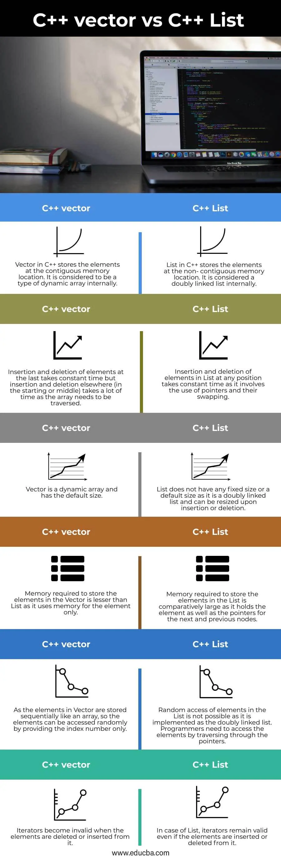
Lists
A double linked list.
Non-continuous memory block (non-continuous memory locations).
New element = new allocated memory (somewhere) and linked to the rest of the list.
An extra memory is needed for pointers to next & previous.
Slow on random access on elements (a need to traverse the list).
Inserting on any given position is O(1).

Slide 252
Tuple
std::tuple is a tuple. 🤷🏿‍♀️
The generalization of std::pair
A handy on multiple return values from functions.
std::tuple<int, int> foo_tuple()
{
return {1, -1}; // Error until N4387 (2015)
return std::tuple<int, int>{1, -1}; // Always works
return std::make_tuple(1, -1); // Always works
}

Slide 253
Sets
Here we go.

Slide 254
Maps
Here we go.

Slide 255
Stacks and queues
Here we go.

Slide 256
Chapter quiz
Here we go.

Slide 257
Standard library containers operations

Slide 258
Browsing containers
#include <iostream>
#include <vector>
#include <algorithm>
int main()
{
std::vector<int> nums{3, 4, 2, 8, 15, 267};
auto print = [](const int& n) {std::cout << " " << n;};
std::cout << "Range based loop: ";
for(const auto & i : nums) {std::cout << i << " ";};
std::cout << '\n';
std::cout << "for_each:";
std::for_each(nums.cbegin(), nums.cend(), print);
std::cout << '\n';
std::cout << "range::for_each:";
std::ranges::for_each(nums, print);
std::cout << '\n';
}
A range-based loop
A std::for_each
A std::for_each_n
A std::ranges::for_each
A std::ranges::for_each_n

Slide 259
Transformations (projections)
A std::transform
A std::ranges::transform
#include <algorithm>
#include <iostream>
#include <string>
int main()
{
std::string s("hello");
auto toUpper = [] (unsigned char c) { return std::toupper(c); };
std::ranges::transform(s, s.begin(), toUpper);
std::cout << s;
}

Slide 260
Non-modify operations
#include <algorithm>
#include <iomanip>
#include <iostream>
#include <string>
int main()
{
static constexpr auto nums
= {1, 2, 2, 3, 4, 1, 2, 2, 2, 1};
constexpr int count{ 3 };
constexpr int value{ 2 };
constexpr auto result
= std::ranges::search_n(
nums.begin(), nums.end(), count, value
);
static_assert( // found
result.size() == count &&
std::distance(nums.begin(), result.begin()) == 6 &&
std::distance(nums.begin(), result.end()) == 9
);
}
A std::(ranges::)count(_if)
A std::(ranges::)find(_if)
A std::(ranges::)find(_end)
A std::(ranges::)search(_n)
A std::(ranges::)binary_search
A std::(ranges::)min(_n)
A std::(ranges::)max(_n)
A std::(ranges::)max_element
A std::(ranges::)min_element

Slide 261
Modify operations
A std::(ranges::)copy(_n)
A std::(ranges::)copy(_if)
A std::(ranges::)fill(_n)
A std::(ranges::)generate(_n)
A std::(ranges::)remove(_if)
A std::(ranges::) replace(_if)

Slide 262
Sort operations
A std::(ranges::)is_sorted(_until)
A std::(ranges::)sort

Slide 263
A many more…
Algorithm standard library

Slide 264
Standard library Pell Mell

Slide 265
Span(s)
C-like array is a contiguous sequence of values of type T in memory.
std::span<T> – a lightweight abstraction of C-like arrays (C++ 20)
Basically a struct { T * ptr; std::size_t length; } with a bunch of convenience methods.
It never allocates nor deallocates anything (except itself) and does not keep smart pointers alive.
When used, we are indicating that the code (that uses a span) does not own the pointer to the memory.
Other implementation are awailable for C++ 17 and earlier (gsl::span, gsl-line span, span-lite, span).

Slide 266
When to (NOT) use spans
(not) In code that uses iterators (basically whole <algorithm> library).
(not) In code that uses arbitary ranges (basically whole <ranges> library).
(not) If you have std::some_container (or Boost) that is right fit.
In situations when raw *T is used and allocated length matters.
int buffer[BUFFER_SIZE];
read_into(buffer, BUFFER_SIZE);
int buffer[BUFFER_SIZE];
read_into(buffer);

Slide 267
Path to std::optional
If you have a function that may fail on execution… …what option do you have how to deal with the failure?
#include <fstream>
#include <iostream>
#include <string_view>
int32_t readBinaryFile(std::string_view path)
{
std::ifstream file(path.data(), std::ios::binary);
if (!file)
{
std::cerr << "Failed to open file: " << path << '\n';
return -1;
}
int32_t value;
if (!file.read(reinterpret_cast<char*>(&value), sizeof(value)))
{
std::cerr << "Failed to read value from file: " << path << '\n';
return -1;
}
return value;
}

Slide 268
std::optional – an optional contained value
std::optional – an alternative to std::pair<T, bool>, exceptions, tuples
It holds a value, or std::nullopt.
std::nullopt is a special null-pointer-like marker (a strongly typed null pointer) indicating no value.
Std::optional can be constructed from nullopt, or = {}
Basically, a compiler assisted null checks.

Slide 269
std::optional III.
#include <fstream>
#include <iostream>
#include <optional>
#include <string_view>
std::optional<int32_t> readBinaryFile(std::string_view path) {
std::ifstream file(path.data(), std::ios::binary);
if (!file) {
std::cerr << "Failed to open file: " << path << '\n';
return std::nullopt;
}
int32_t value;
if (!file.read(reinterpret_cast<char*>(&value), sizeof(value))) {
std::cerr << "Failed to read value from file: " << path << '\n';
return std::nullopt;
}
return value;
}
Notes:
A Wall of Your std::optional Examples - C++ Stories (cppstories.com)

Slide 270
std::optional – monadic extensions
and_then – returns the result of the given function on the contained value if it exists, or an empty optional otherwise.
or_else – returns the optional itself if it contains a value, or the result of the given function otherwise.
transform – returns an optional containing the transformed contained value if it exists (from the given function), or an empty optional otherwise
transform – generaly expects a function that returns a non-optional value that is packed to std::optional.
and_then – operates over std::optional only, error otherwise.

Slide 271
std::expected – a value, or an error
std::expected – an alternative to std::pair<T, E>, or std::optional<T>
C++23 feature
std::expected<T, E> – either holds an expected value T, or unexpected value of type E.
Never valueless (no need to check for null pointers).
#include <iostream>
#include <string>
#include <expected.hpp>
std::expected<std::string, int> divide(int a, int b) {
if (b == 0) {
return std::make_unexpected(0);
}
return std::to_string(a / b);
}
int main() {
auto result = divide(10, 2);
if (result.has_value()) {
std::cout << "Result: " << result.value() << std::endl;
} else {
std::cout << "Error: " << result.error() << std::endl;
}
}

Slide 272
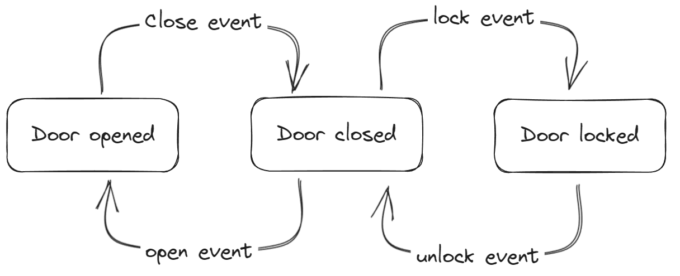
Path to std::variant
Try to implement a state machine for a door, see chart below.
Do whatever implementation you can produce. No limits here. Just do it by yourself.
For fun: Later, try to generate solution by AI.

Slide 273
std::variant – a generic discriminated union
A class template that represents a type-safe union, a.k.a. a discriminated union.
The templated is supported by bunch of template functions to operate over or with std::variant.
Syntax: std::variant<T1, T2, T3,…>
A low memory footprint (max(sizeof(T1), sizeof(T2),…, sizeof(Tn) + state).
By default, it initialize by the default of the first alternative (std::variant<int, std::string> s; // holds int 0)
Holding a value is not guaranteed (an exception upon saving new state after clearing the old state)
You can get creative and do monadic composition. 😎

Slide 274
std::variant – supporting functions
std::get<n> – gets the Nth alternative from a std::variant
std::get_if<n> – gets the value requested by the index (from 0) only if the value exists
std::visit – allows visit a variant in any state.
std::holds_alternative<T> – tests if a variant has T alternative set.
std::variant::index – a member function of the variant class that returns an index of the set alternative.
std::variant::valueless_by_exception – a member function of the variant class that returns if a variant has value (and failed upon exception).
Std::monostate

Slide 275
std::visit
A way how to invoke an operation on the currently active type in the variant.
A callable object with overloads for all the possible types in the variant.

Slide 276
Coroutines and Concurrency

Slide 277
What it is all about?
Generalized functions that can be suspended and resumed while keeping their state.
Typical use for cooperative multitasking.
Another use case is event-driven applications (simulations, games, servers, user interfaces, or some algorithms).
C++20 doesn't provide concrete coroutines but provides a framework for writing our coroutines.

Slide 278
Modules

Slide 279
About modules
Modules solves one of the biggest problem of C++ => the order of includes should not matter => but it does
See following example
#include <string>
#include "Employee.h"
int main()
{
std::string name = "Kate";
Employee someone;
int limit = 10;
//int LIMIT = 30;
}
class Employee
{
private:
std::string fullname;
public:
//TODO WRITE THIS
};
#define LIMIT 50
Will this build? 🤔

Slide 280
How about this? 🤔
#include "Employee.h"
#include <string>
int main()
{
std::string name = "Kate";
Employee someone;
int limit = 10;
//int LIMIT = 30;
}
class Employee
{
private:
std::string fullname;
public:
//TODO WRITE THIS
};
#define LIMIT 50

Slide 281
How about this? 🤔
//#include "Employee.h"
int main()
{
std::string name = "Kate";
// After some time, some change,
// I don't need the Empoyee and its header file, right?
//Employee someone;
int limit = 10;
//int LIMIT = 30;
}
#include <string>
class Employee
{
private:
std::string fullname;
public:
//TODO WRITE THIS
};
#define LIMIT 50
Use of string is leaking out

Slide 282
How about this? 🤔
#include <string>
#include "Employee.h"
int main()
{
std::string name = "Kate";
Employee someone;
int limit = 10;
int LIMIT = 30;
}
#include <string>
class Employee
{
private:
std::string fullname;
public:
//TODO WRITE THIS
};
#define LIMIT 50
Implementation details is leaking out from the header

Slide 283
So… About modules again
export module Employee;
import <string>;
export class Employee
{
private:
std::string fullname;
public:
//TODO WRITE THIS
};
#define LIMIT 50
Modules solves one of the biggest problem of C++ – the include hell.
Modules removes tedious errors related with the order of includes.
Modules solves the leakage of implementation details from include files.
Modules are finally the modern way how to manage includes!
10 years from now, nobody would care about includes header files (hopefully).
import <string>;
import Employee;
int main()
{
std::string name = "Else";
Employee someone;
int limit = 10;
int LIMIT = 30; }

Slide 284
Notes about module implementation
Classes brings namespaces with them automatically (we don't have to import namespaces).
We can't do partial import (partion units maybe 🤔)

Slide 285
C++20 dialect news

Slide 286
C++20 gave us
Big 4 – Concepts (1)
Big 4 – Ranges (2)
Big 4 – Modules (3)
Big 4 – Coroutines (4)
Spaceship operator
Extension of use of constexpr – see this example (change 50 to 3)

Slide 287
C++23 dialect news

Slide 288
C++23 gave us
std::format - a type-safe and extensible formatting library.
std::spanstream - a stream that writes to a std::span.
std::generator - a generator function that can be used with range-based for loops.
std::stacktrace - a class that represents a stack trace.
std::mdspan - a multidimensional array view.
std::flat_map and std::flat_set - containers that store their elements in sorted order.
std::expected - a discriminated union of two types, usually a type that represents either an expected value or an error value¹.

Slide 289
Best practices with C/C++ (not only embedded)

Slide 290
Some advices for future work #BestPractice
Test, do not assume! The final code is a result of combination of the compiler version, its setting, C++ dialect, bugs in the implementations. It is hard to predict something, so do not assume, test your thoughts! #TDD
Consider const as a default => put it everywhere you can.
If you can use something from STL, use it.
Do not use raw new calls -> use smart pointers.
Do not call virtual methods in constructors (not resolved in runtime).
Virtual keyword can be added automatically (to the derived class method with the same signature when the base class has virtual).
Place using std::whatever into the block {you code} where you plan to use it.
Do you have an order in your repo?

Slide 291
Some advices for future work II. #BestPractice
Try to avoid any undetermined/implementation-based behaviour.
ETL – Embedded Template Library

Slide 292
What next?

Slide 293
What to learn next? What should be the next step?
Get familiar with Boost.
How about ReSharper for C++.
Ton of useful links.
W3 resources – another good step-by-step C++ overview with tasks
Microsoft STL C++ source code on GitHub
Fundamentals for C++ course by Rainer Grimm
Kate Gregory courses on Pluralsight
C++ Core Guidelines

Slide 294
FAQ

Slide 295
What is difference between gcc and g++?
See the answer here.

Slide 296
Does C support inheritance? No, but…
You can write OOP-like code in C, because vtable is necessary fundament of polymorphism and vtable can be implemented in C.
See this link, or this link.

Slide 297
How to supply a flag for encoding to ifstream?

Slide 298
How to limit a template?
In C++20 by concepts, see this link.

Slide 299
Specific lecture code

Slide 300
Lecture code links to download
20.-22. 9. 2022 - Link

Slide 301
THANK you for your time and good luck with C++

Slide 302
Used tools
Interview Bit online IDE for coloring syntax for syntax coloring
Compiler Explorer to come output of various compiler version and many more
Coliru (stacked-crooked.com) online compiler with CMD setup
Jetbrain ReSharper C++ - an extension for Visual Studio for analysis C++ code
CodeMaid - ----- || -----
Visual Assist

Slide 303
Makefile and build systems

Slide 304
Makefiles
Make files are files which are responsible for compilation & linking of project files into executable product.
Original implementation is called make.

Slide 305
Build systems
Here we go

Slide 306
Parallel programming

Slide 307
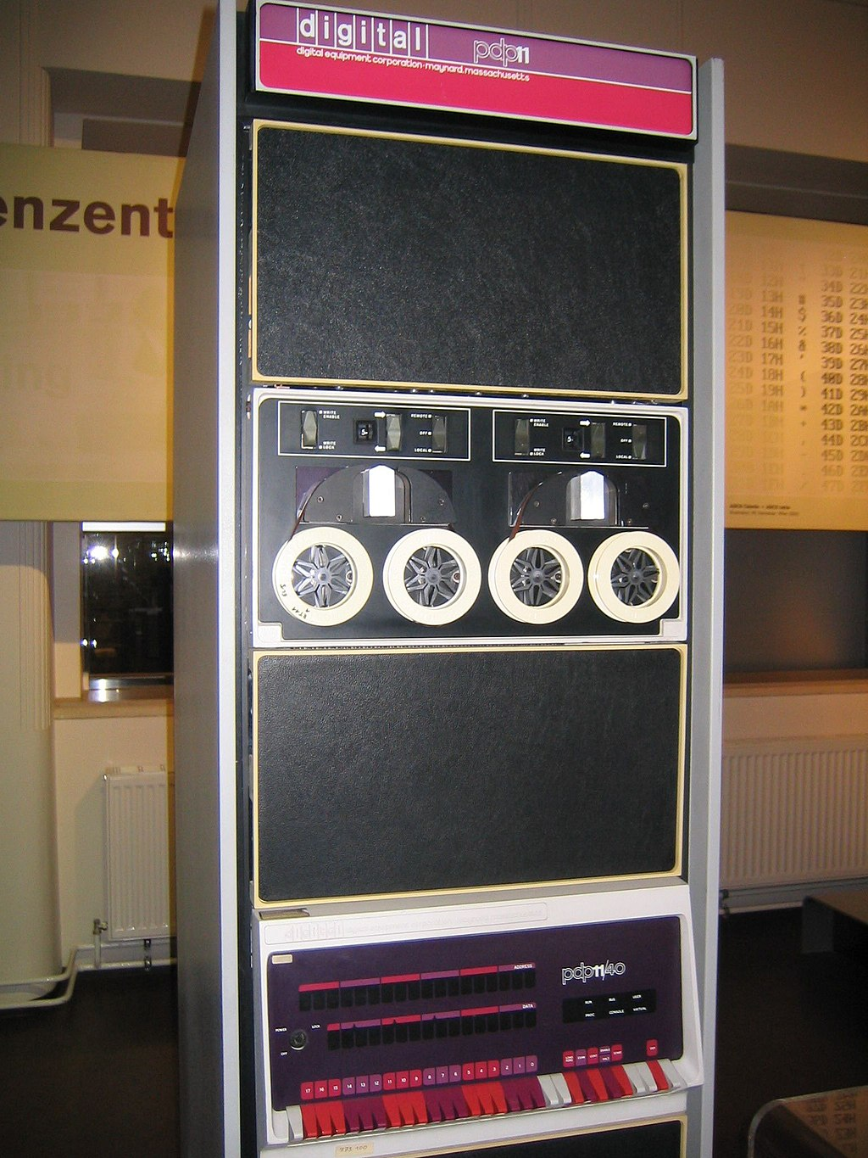
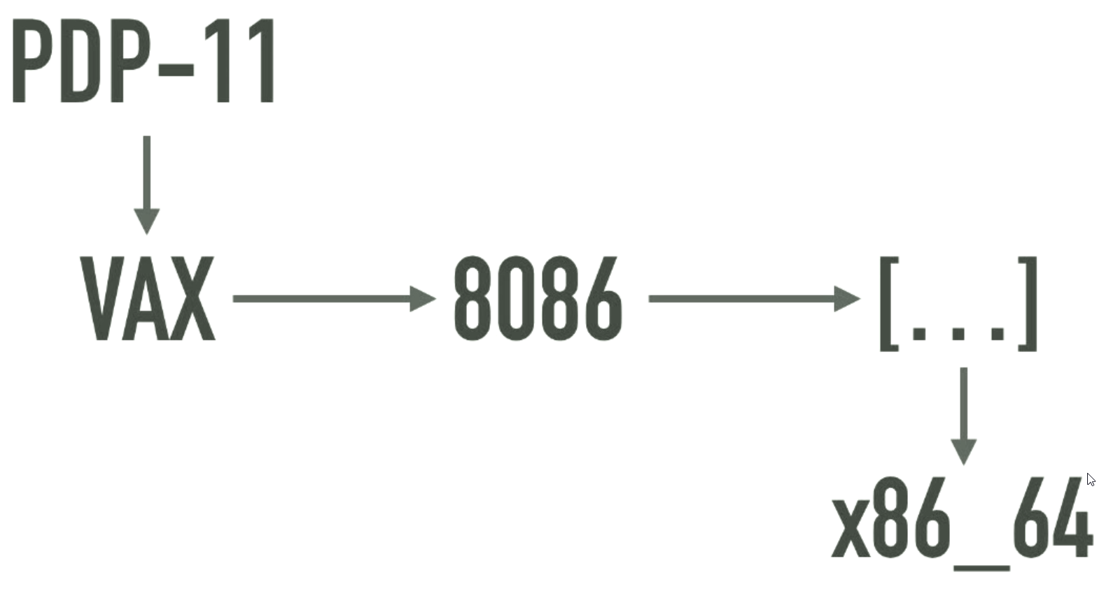
About parallelization in C – the legacy of PDP-11
C was written mainly for PDP-11.
PDP-11 was a single core, single CPU with simple memory structure with orthogonal instruction set (only move and memory mapped I/O), so no cores, no threading, no L3, L2, L1 cache (a memory hierarchy), no speculative execution…
…just bytes from one point to another
C is just bunch of implementation details of PDP-11 and its memory

Slide 308
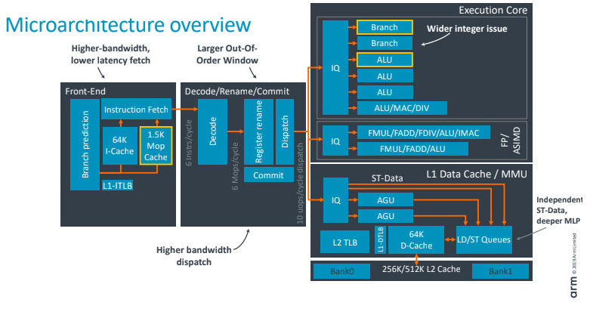
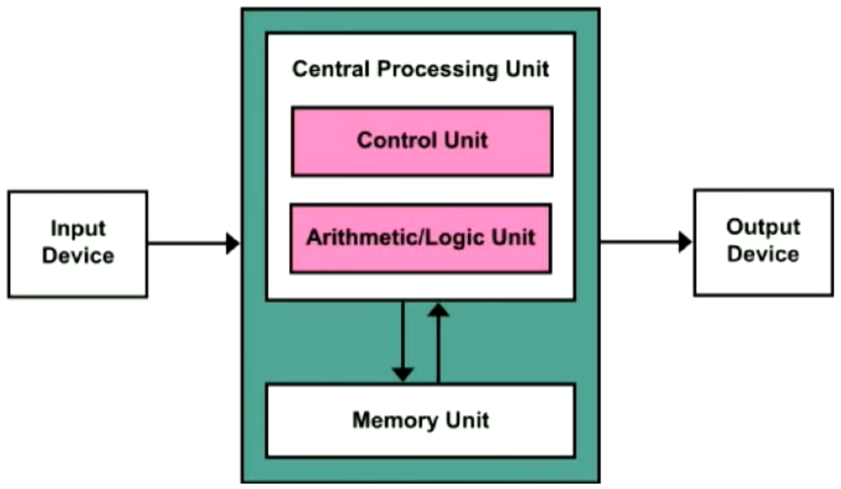
A quiz…
One picture is almost 1:1 description of PDP-11 CPU functionality and the other is a simplified scheme of modern ARM CPU architecture.
What is what? 🤔

Slide 309
OK… What’s the point? 🤷🏿‍♀️
Do you really need C?
Is there any better, modern, more versatile alternative? Maybe not thaaat fast, but with better interpretation of your domain & data?
It isn’t 1969, we don’t have simple problems in simple domains.
Data are more complex and simple byte interpretation should not matter.
In 99,2 % of cases, an average developer have no idea what is the optimal way how to properly optimize the code for a specific hardware.

Slide 310
Thread in C
No native support in C for threads or synchronization until C11.
One approach is based on POSIX Threads (Pthreads) <pthread.h>.
A clunky code, but it works.
int main(int argc, char *argv[])
{
pthread_t threads[NTHREADS];
int thread_args[NTHREADS];
int rc, i;
/* spawn the threads */
for (i=0; i < NTHREADS; ++i){
thread_args[i] = i;
printf("spawning thread %d\n", i);
rc = pthread_create(&threads[i], NULL, myFun, (void *) & thread_args[i]);
}
/* wait for threads to finish */
for (i=0; i < NTHREADS; ++i) {
rc = pthread_join(threads[i], NULL);
}
}
#include <stdio.h>
#include <stdlib.h>
#include <pthread.h>
#define NTHREADS 5
void * myFun(void * x){
int tid = *((int *) x);
printf("Hi from thread %d!\n", tid);
return NULL;
}

Slide 311
Threads in C11
C11 gave us threads and synchronization support by <threads.h>.
Very similar concept like Pthread.
As always, it must be supported by compiler and included by your build system.
Support was (is???) poor, see this.
See this compilation failure in CppReference.com
A code example, see Atomic variables.

Slide 312
OpenMP
Other possible approach is via OpenMP – a high-level extension to C/C++ for multiprocessing.
A high-level library for C/C++/Fortran
Sample of OpenMP C parallel programing

Slide 313
Threads and synchronizations in Pthread
#include <stdlib.h>
#include <stdio.h>
#include <pthread.h>
int mails = 0;
pthread_mutex_t mutex;
void * routine(void * args) {
for (int i = 0; i < 10000000; i++) {
pthread_mutex_lock(&mutex);
mails++; // critical section of code, needs synchro
pthread_mutex_unlock(&mutex);
// other work
}
return NULL;
}
int main(int argc, char* argv[]) {
pthread_t p1, p2;
pthread_mutex_init(&mutex, NULL);
if (pthread_create(&p1, NULL, &routine, NULL) != 0) {return 1;}
if (pthread_create(&p2, NULL, &routine, NULL) != 0) {return 2;}
if (pthread_join(p1, NULL) != 0) {return 3;}
if (pthread_join(p2, NULL) != 0) {return 4;}
pthread_mutex_destroy(&mutex);
printf("Number of mails: %d\n", mails);
return 0;
}
Pthreads library has its own synchronization mutex that can be used.
Mutex = Mutual Exclusion

Slide 314
Shared data
#include <stdlib.h>
#include <stdio.h>
#include <pthread.h>
typedef struct{
int counter;
pthread_mutex_t mutex;
} shared_resources;
void touch_shared_resources(shared_resources * shared_things) {
pthread_mutex_lock(&shared_things->mutex);
shared_things->counter++;
pthread_mutex_unlock(&shared_things->mutex);
}
void * routine(void * args) {
shared_resources * shared = (shared_resources *)args;
int i = 0;
while (shared->counter < 1000000) {
touch_shared_resources(shared);
i++;
}
printf("Number of thread writes: %d\n", i);
return NULL;
}
int main(int argc, char* argv[]) {
pthread_t p1, p2;
shared_resources sharedResources;
if (pthread_create(&p1, NULL, &routine, &sharedResources) != 0) {return 1;}
if (pthread_create(&p2, NULL, &routine, &sharedResources) != 0) {return 2;}
if (pthread_join(p1, NULL) != 0) {return 3;}
if (pthread_join(p2, NULL) != 0) {return 4;}
printf("Number of of calls: %d\n", sharedResources.counter);
return 0;
}
This code produce an interesting error. Could you guess what is it? 🤔
Global variables 😱 (from outer scope).
Static variables (between threads).
If possible, keep data immutable. No need for synchronization until you just read the state from the variables.
“Smart” structures => a mutable state should be protected by mutex.

Slide 315
Shared data structures (between processes)
Generally, a complicated, platform specific, problem.
One possible solution is serialization to a file.
Another is a process wrapper which would wrap the processes.
Another approach is a client-server architecture.

Slide 316
Lock-free data structures
Structures without a need for mutex.
One approach is non-mutable state across threads (data is constant for threads).
Other approach is the thread result aggregation synchronously (run the previous slide code example to see possible aggregation).

Slide 317
Concurrency of conflicting operations
Scheduling strategy
Last operation wins
The least damage strategy

Slide 318
Atomic variables
#include <stdio.h>
#include <threads.h>
#include <stdatomic.h>
atomic_int acnt;
int cnt;
int f(void* thr_data)
{
for(int n = 0; n < 1000; ++n) {
++cnt;
++acnt;
}
}
int main(void)
{
thrd_t thr[10];
for(int n = 0; n < 10; ++n){thrd_create(&thr[n], f, NULL);}
for(int n = 0; n < 10; ++n){thrd_join(thr[n], NULL);}
printf("The atomic counter is %u\n", acnt);
printf("The non-atomic counter is %u\n", cnt);
}
To save ourselves the troubles with mutexing.
Special types for type primitives supporting thread-safe atomic operations.
Since C11
_Atomic const int * p1; // an atomic const int pointer
const atomic_int * p2; // same
const _Atomic(int) * p3; // same

Slide 319
Scheduler and event loops

Slide 320
Even driven programming
Here we go

Slide 321
Function callbacks
Here we go

Slide 322
Deferred execution
Here we go

Slide 323
Polymorphism

Slide 324
Callbacks a data
Here we go

Slide 325
Tagged polymorphism
Here we go

Slide 326
Structures with functions
Here we go

Slide 327
Dynamic call handling
Here we go

Slide 328
Elements of object-oriented programming

Slide 329
Nested structures
Here we go

Slide 330
Type information at runtime
Here we go

Slide 331

Links
KUTlime/C-CppCourse: > A source code for C/C++ course (all levels).

